Slide 2
An Active School
The overall aim is to increase the children’s daily physical activity throughout the school day
By increasing the amount of physical activity the children do at school, the school day is energized.
Increased physical activity promotes the physical and mental well being of the children.
We provide opportunities for physical activity
- Active yards and active lines
- Brain breaks/ movement breaks

Slide 3
An Active School
Naul N.S is currently working towards attaining the Active Schools flag.
This is a two year process and so far we have made some great improvements to the way we approach Physical Education in our school.

Slide 4
An Active School
Examples of positive changes introduced over the past 3 years are:
A whole school standardised timetable for P.E ensuring a balanced coverage of all strands of the P.E curriculum throughout the year.
Active Yard breaks with Active Line leaders, Playground leaders and P.E Equipment monitors
Swimming lessons (2019 and 2020)
After school activities such as Rinka and soccer (2019 and 2020)
We are in the process of purchasing a mobile outdoor sound system to enable the children to dance outdoors during yard breaks and P.E.

Slide 5
Physical Education
All classes are timetabled for 60 minutes of physical education every week.
A broad and balanced P.E curriculum is taught at all levels by the classroom teacher using a range of P.E teaching resources and equipment
Games, Aquatics, Athletics, Dance and Outdoor activities are the 5 P.E strands that are covered each year
Due to Naul N.S not having a P.E hall and gymnastics equipment, we are limited in the amount of Gymnastics we can teach

Slide 6
Physical Education
Last February all the children worked on creating a school slogan for Active School’s.
All the children designed a poster with a slogan and this is the one we chose for Naul N.S.
Be Wise, Exercise!

Slide 7
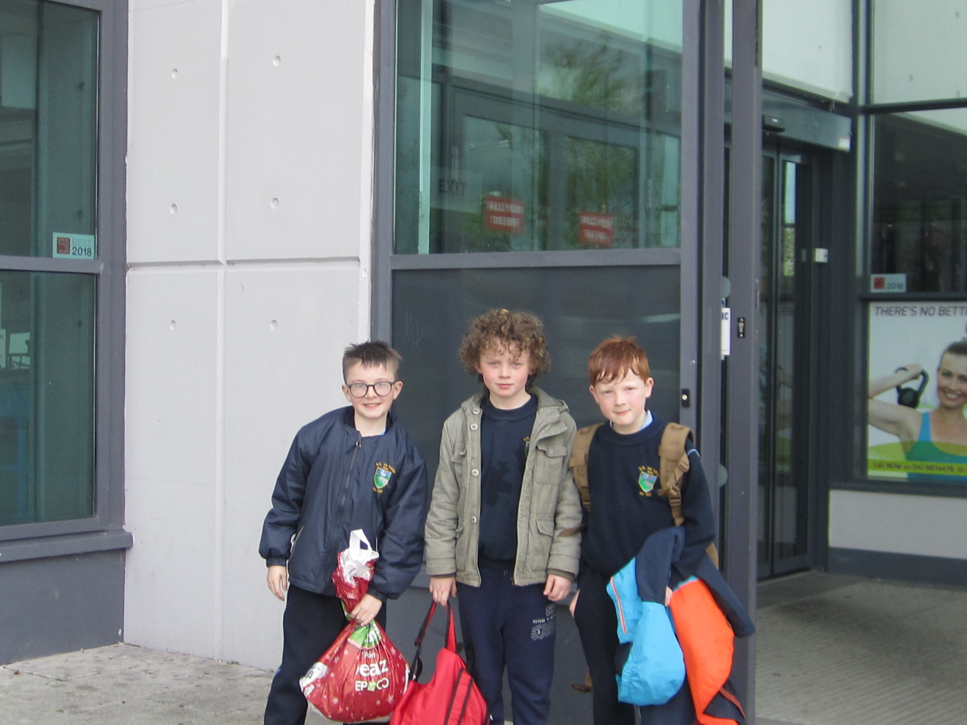
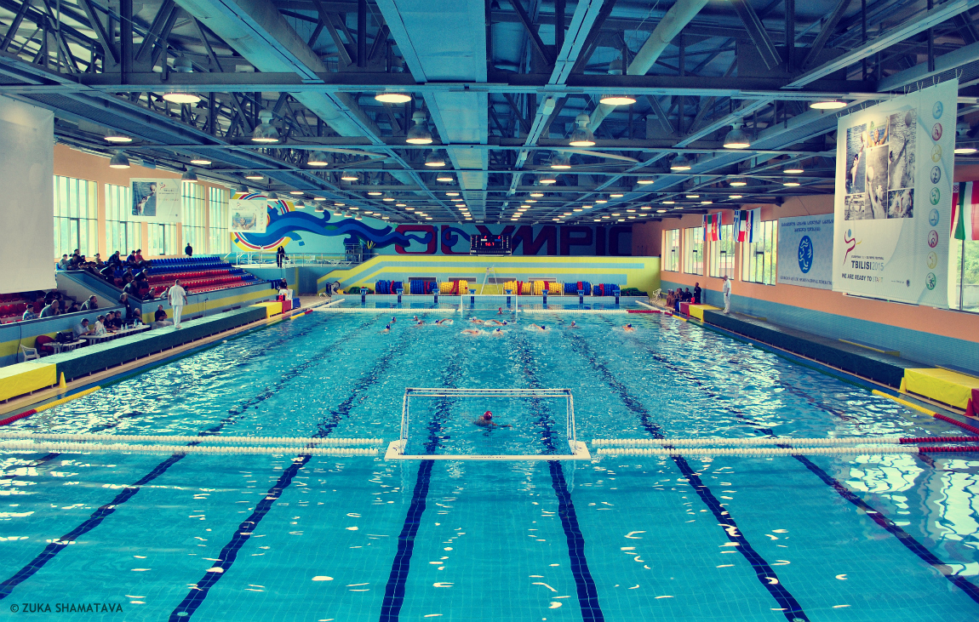
Aquatics
This Photo by Unknown Author is licensed under CC BY-NC
We introduced swimming lessons in Aura in 2019 and 2020 for 3rd to 6th class.
This Photo by Unknown Author is licensed under CC BY-SA

Slide 8
Aquatics
This Photo by Unknown Author is licensed under CC BY-NC
The PAWS (Primary Aquatics Water Safety) programme is taught in all classes3
This teaches basic water safety skills6th class.

Slide 9
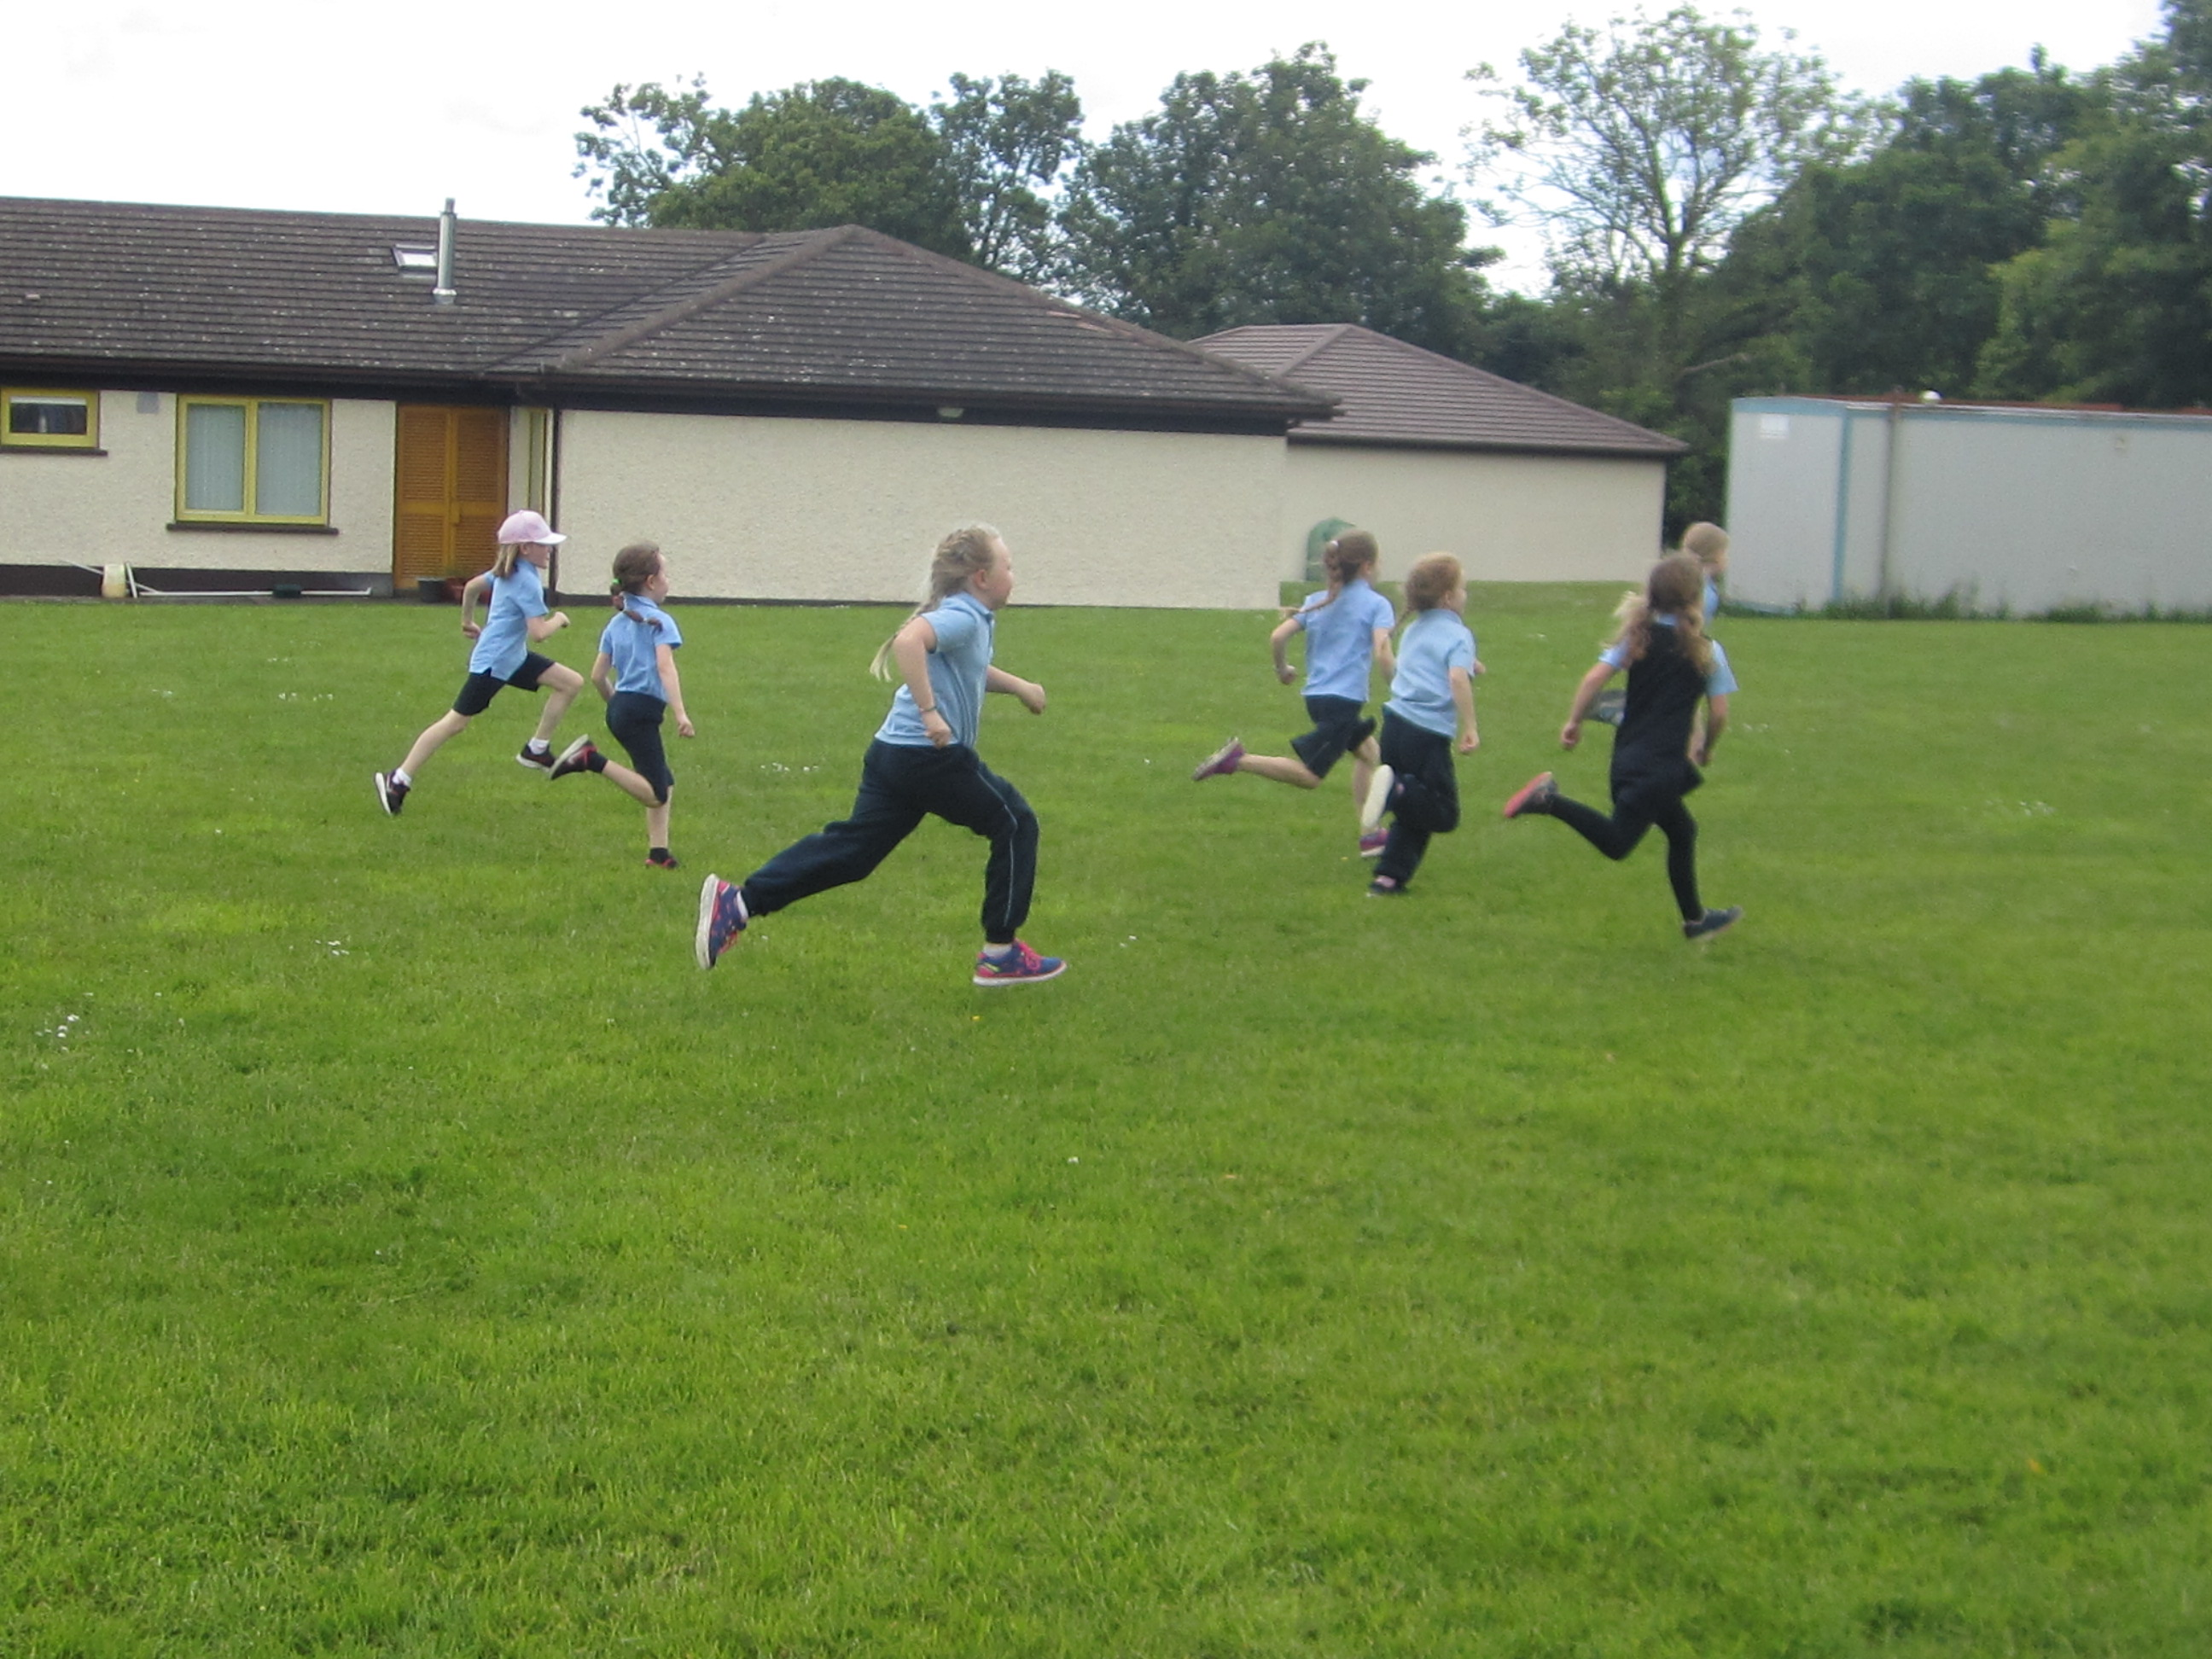
Athletics

Slide 10
Dance
The children love to dance to Gonoodle for movement breaks or P.E. lessons.
Dance is the priority strand we are working to improve upon this year.
We plan to introduce outdoor dance for P.E and during active yard breaks once we purchase our outdoor sound system!
This Photo by Unknown Author is licensed under CC BY

Slide 11
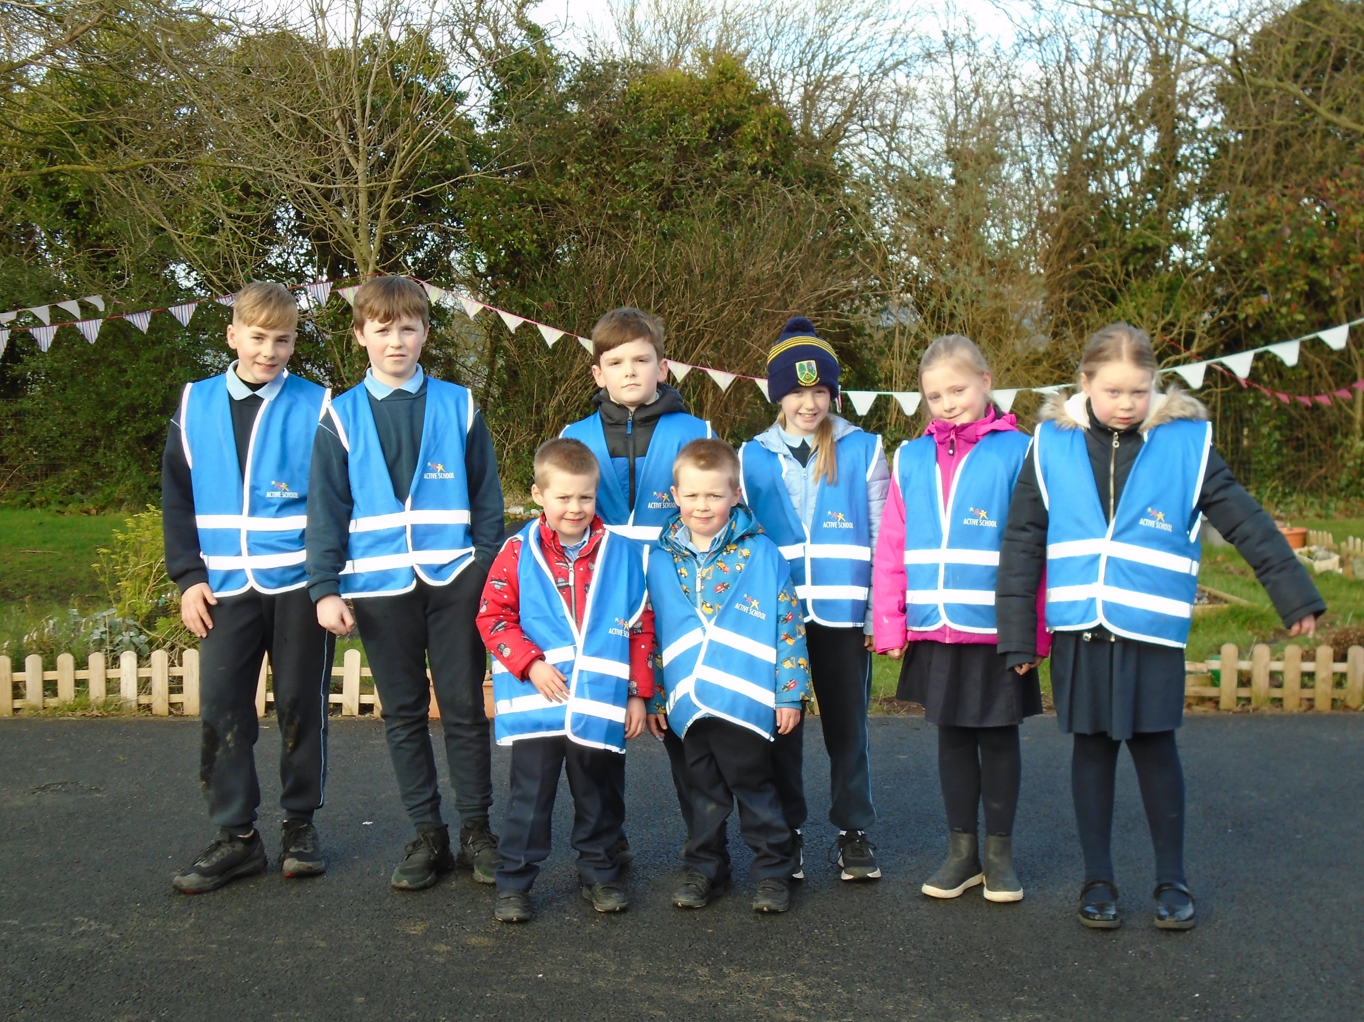
Active School Committee

Slide 12
Physical Activity
Active School Committee
They have an important role in leading the process. Some of their responsibilities include:
attending ASF meetings regularly and share the information and new steps to be taken with their class.
Take out, organise and return P.E equipment at Active Breaks
Help teach pupils yard games
Act as line leaders demonstrating exercises and motivating their class to take part.

Slide 13
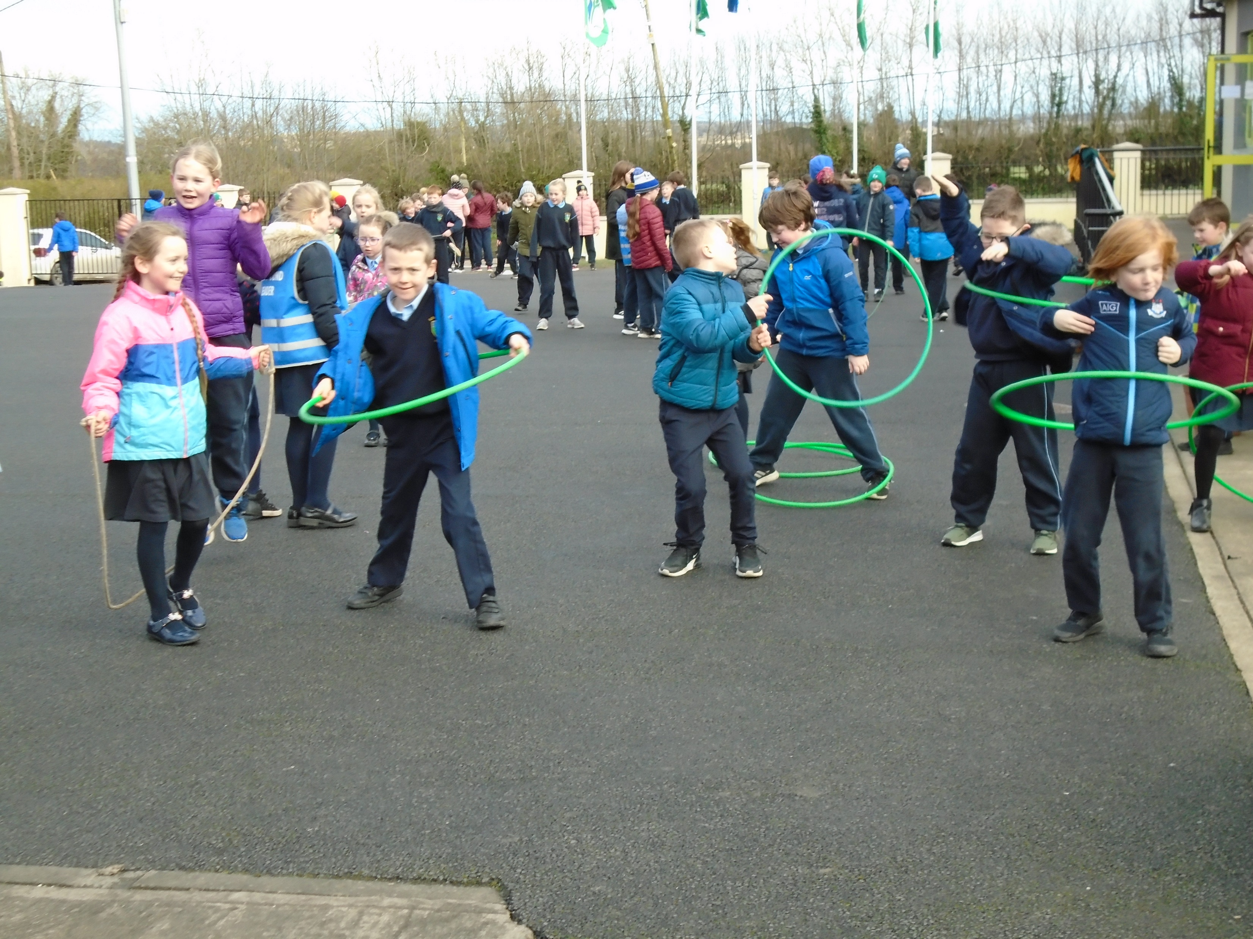
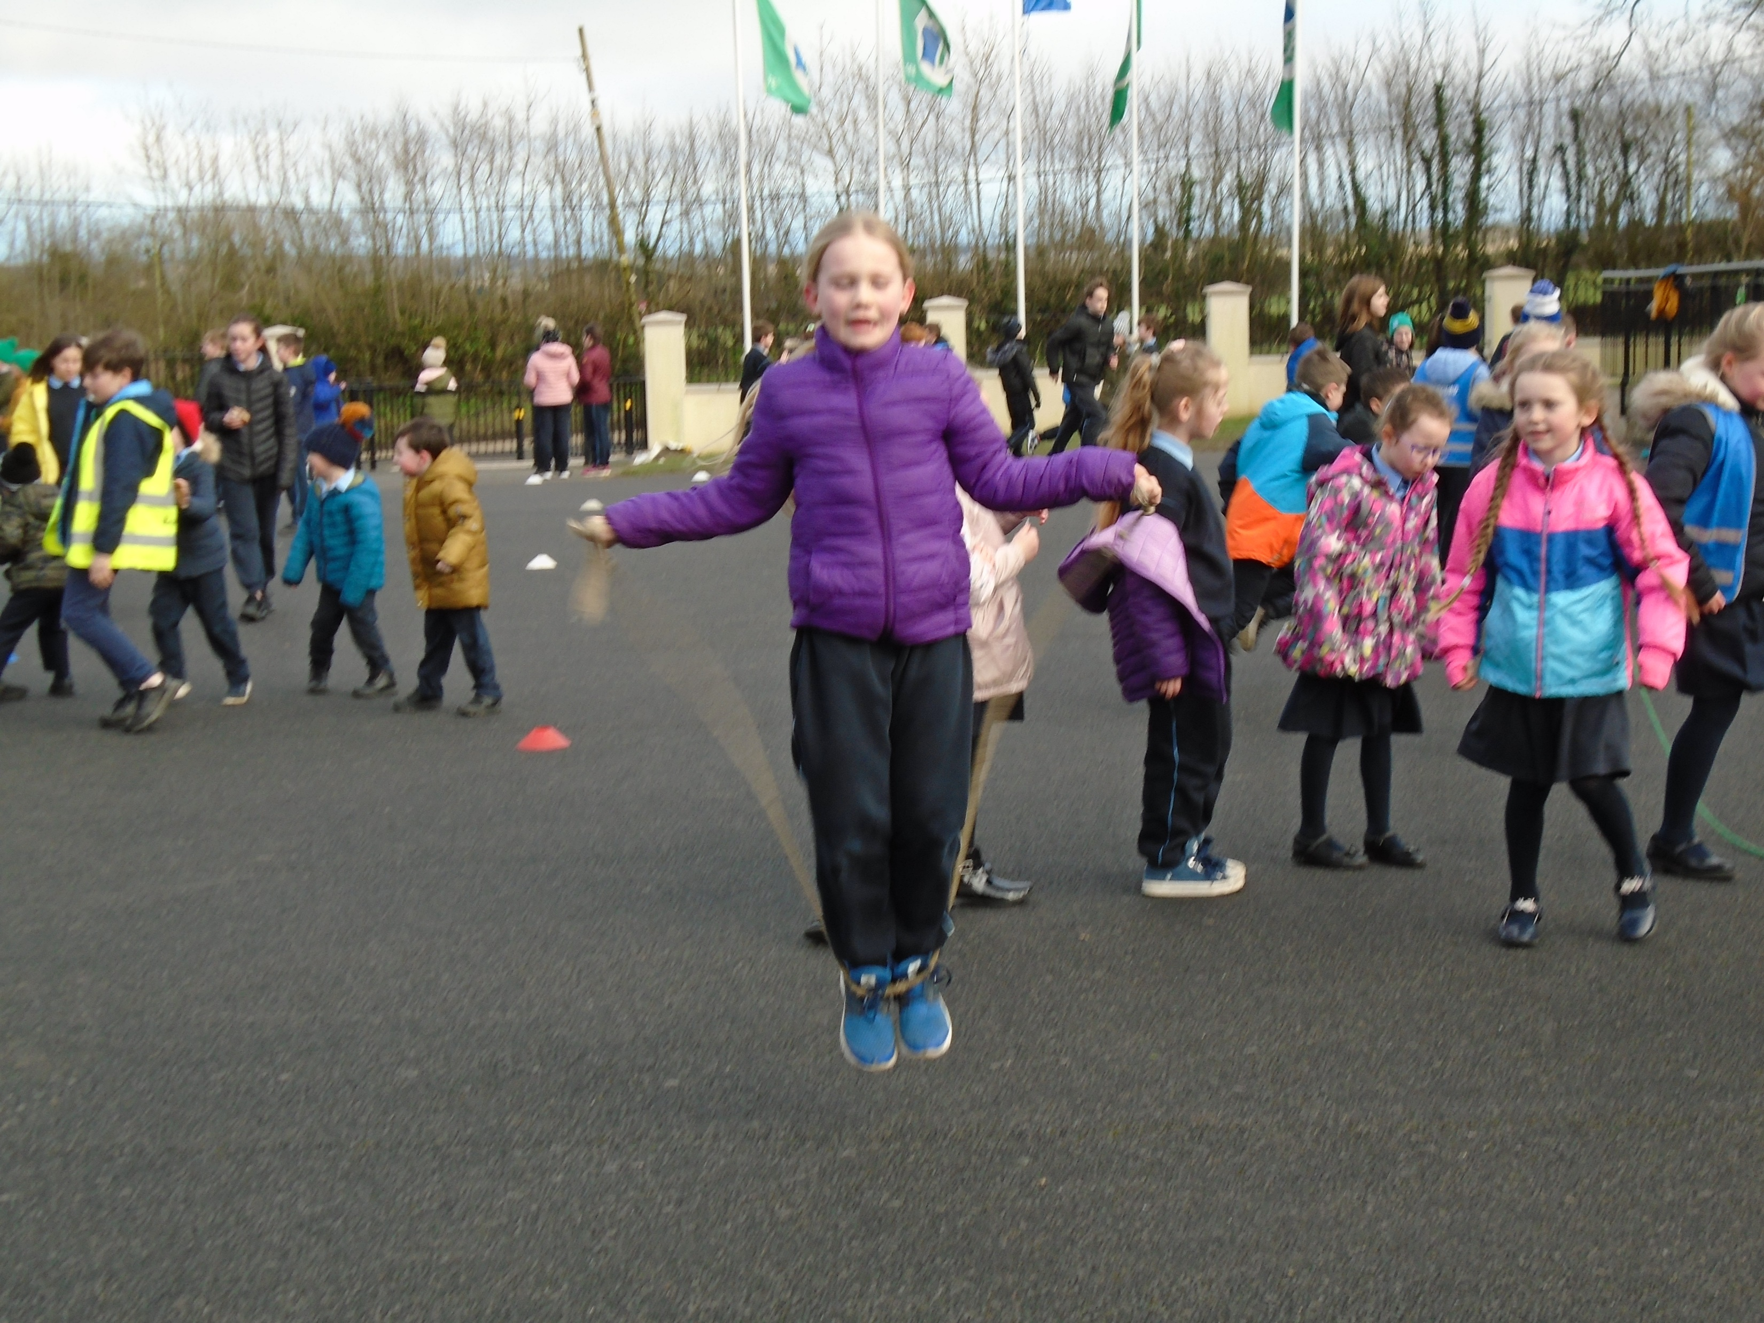
Physical Activity
Naul N.S promotes inclusive physical activity throughout the school day.

Slide 14
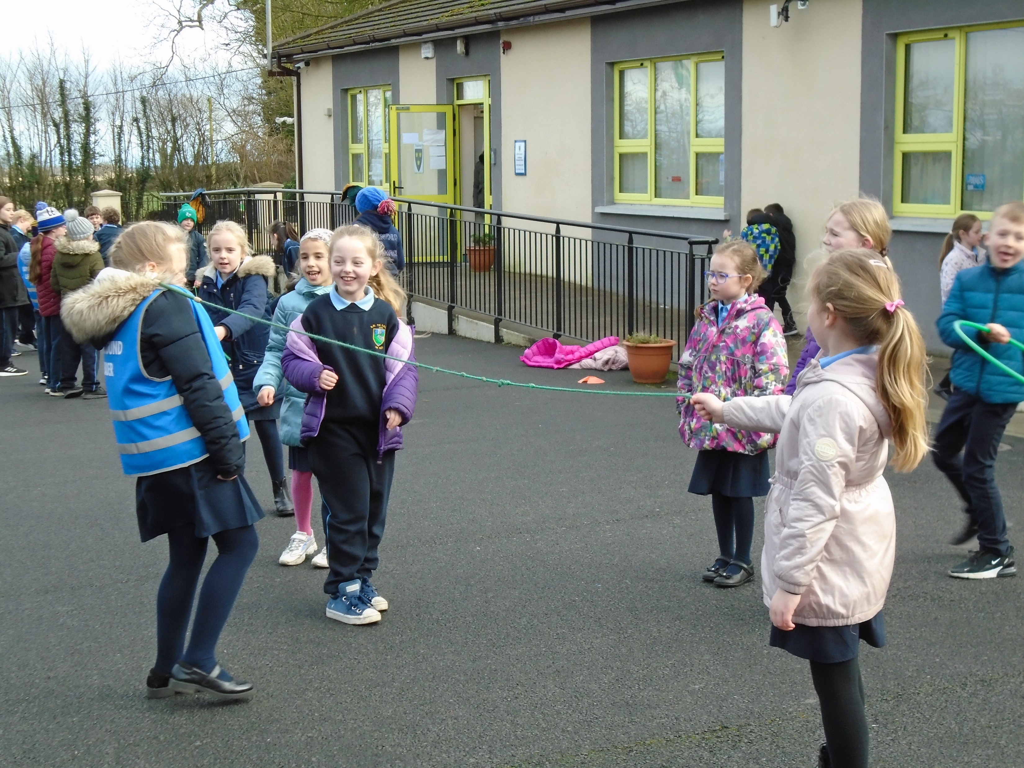
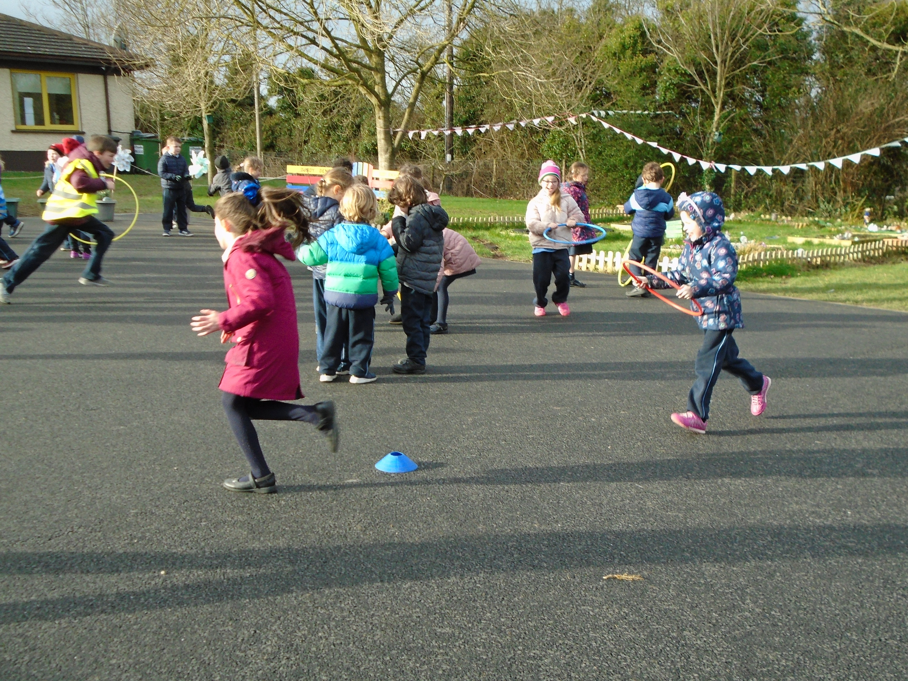
Physical Activity
Active Playgrounds

Slide 15
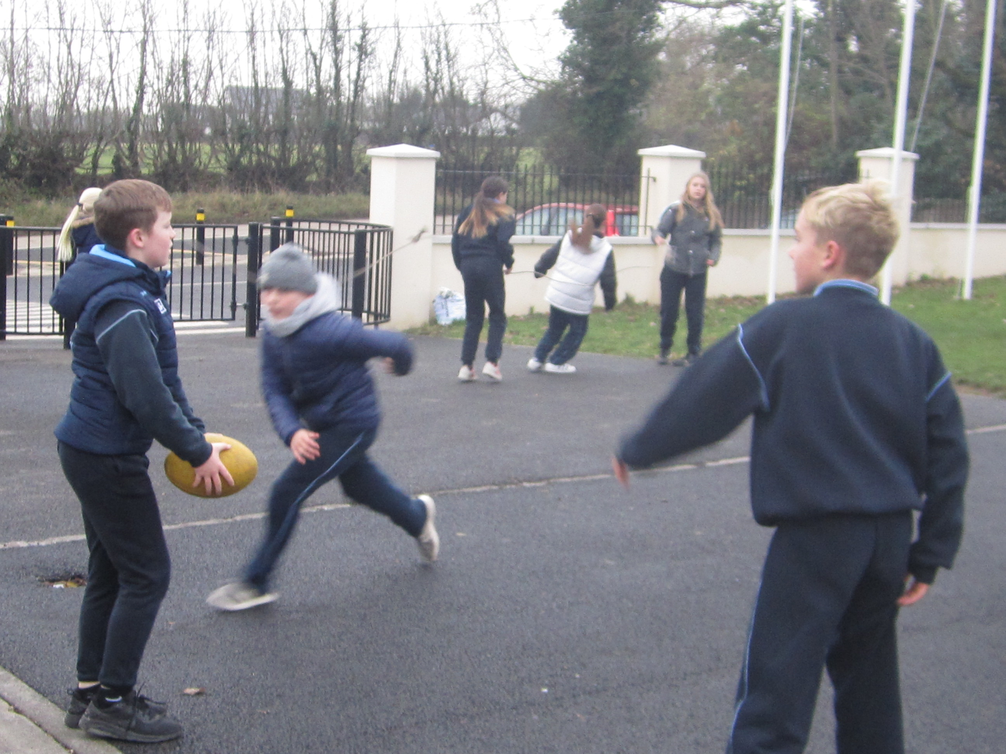
Physical Activity
Active Playgrounds
Skipping ropes, hoolahoops, footballs are timetabled for use during yard breaks.
Old schoolyard games such as elastics and hopscotch were introduced.
Exercise circuits will be introduced after the Easter break
2021.

Slide 16
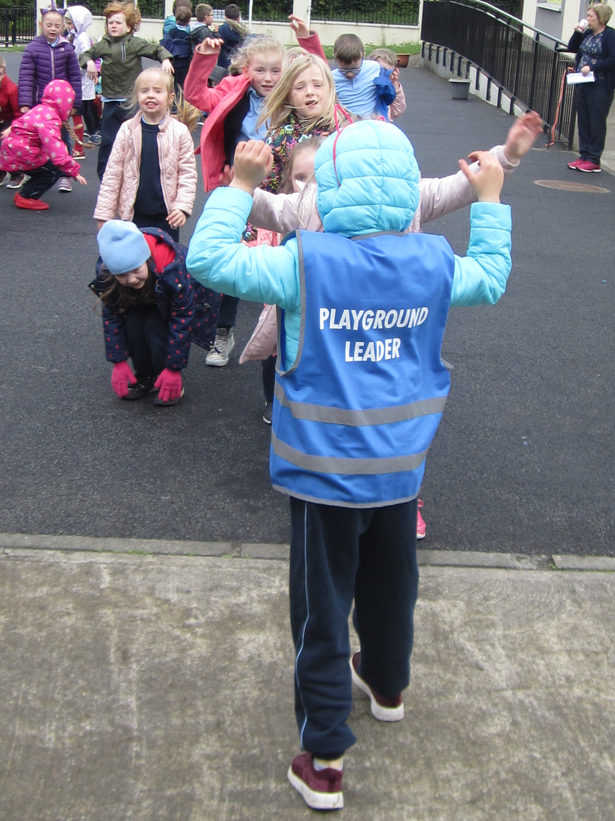
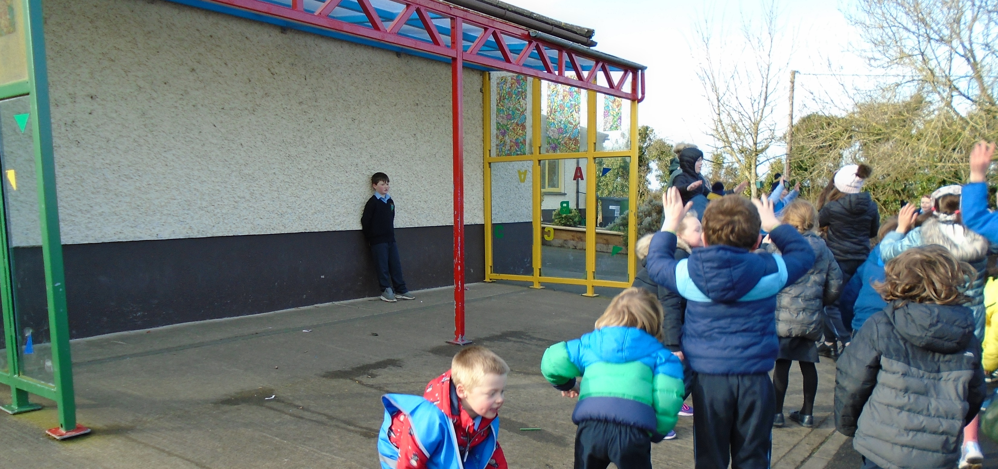
Physical Activity
Active Line Leaders
The line leaders perform exercises for the classes to do
They keep their classes physically active before their return to class!

Slide 17
Initiatives to promote Physical Activity
In Naul N.S we are of the mindset that physical activity should be built into the school day daily and not just at set P.E times.
Walk around Europe Challenge
Active Break every day Challenge (running/ dance/ exercise break)
Super Troopers Homework booklet 2020
Walk to school initiative (wear high viz jackets) 2019
Brain breaks, Rainy day breaks and Go Noodle.

Slide 18
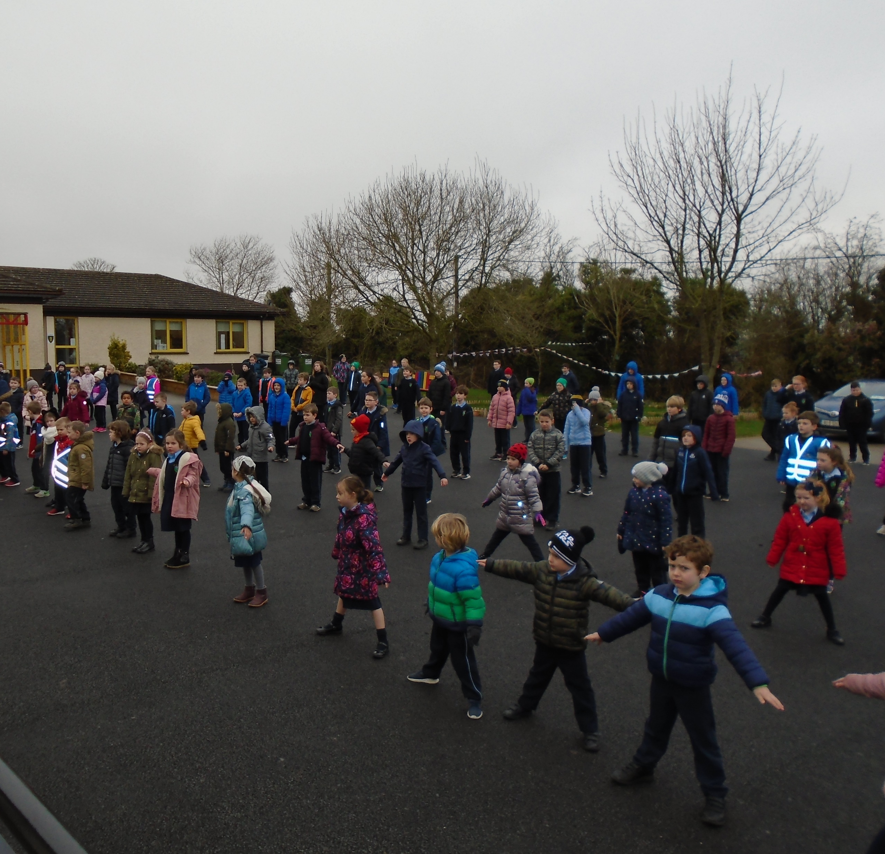
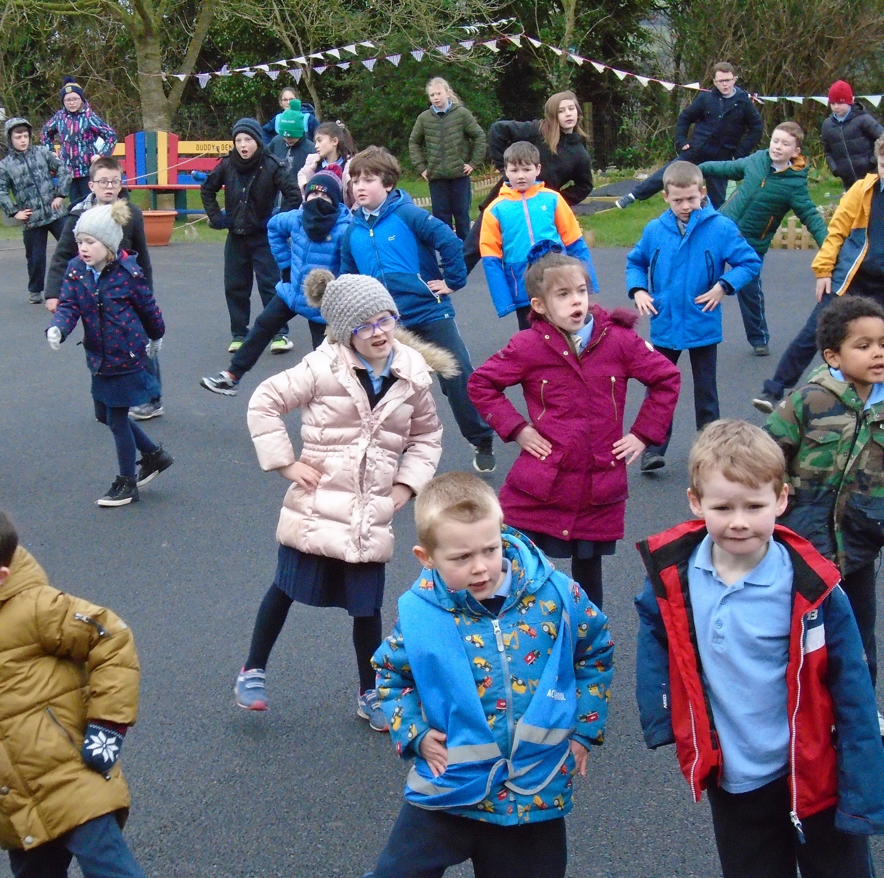
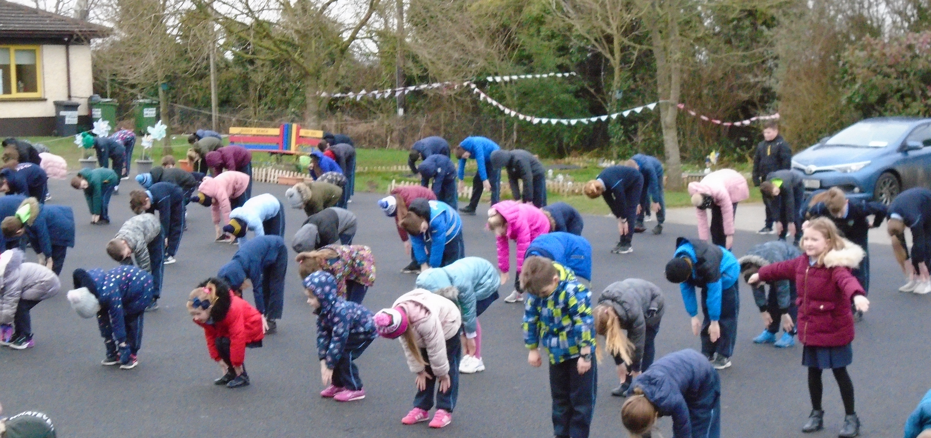
Wellbeing Week 2019
Operation Transformation (10 @ 10)
All the pupils and teachers took part
It was great fun and it energized us!

Slide 19
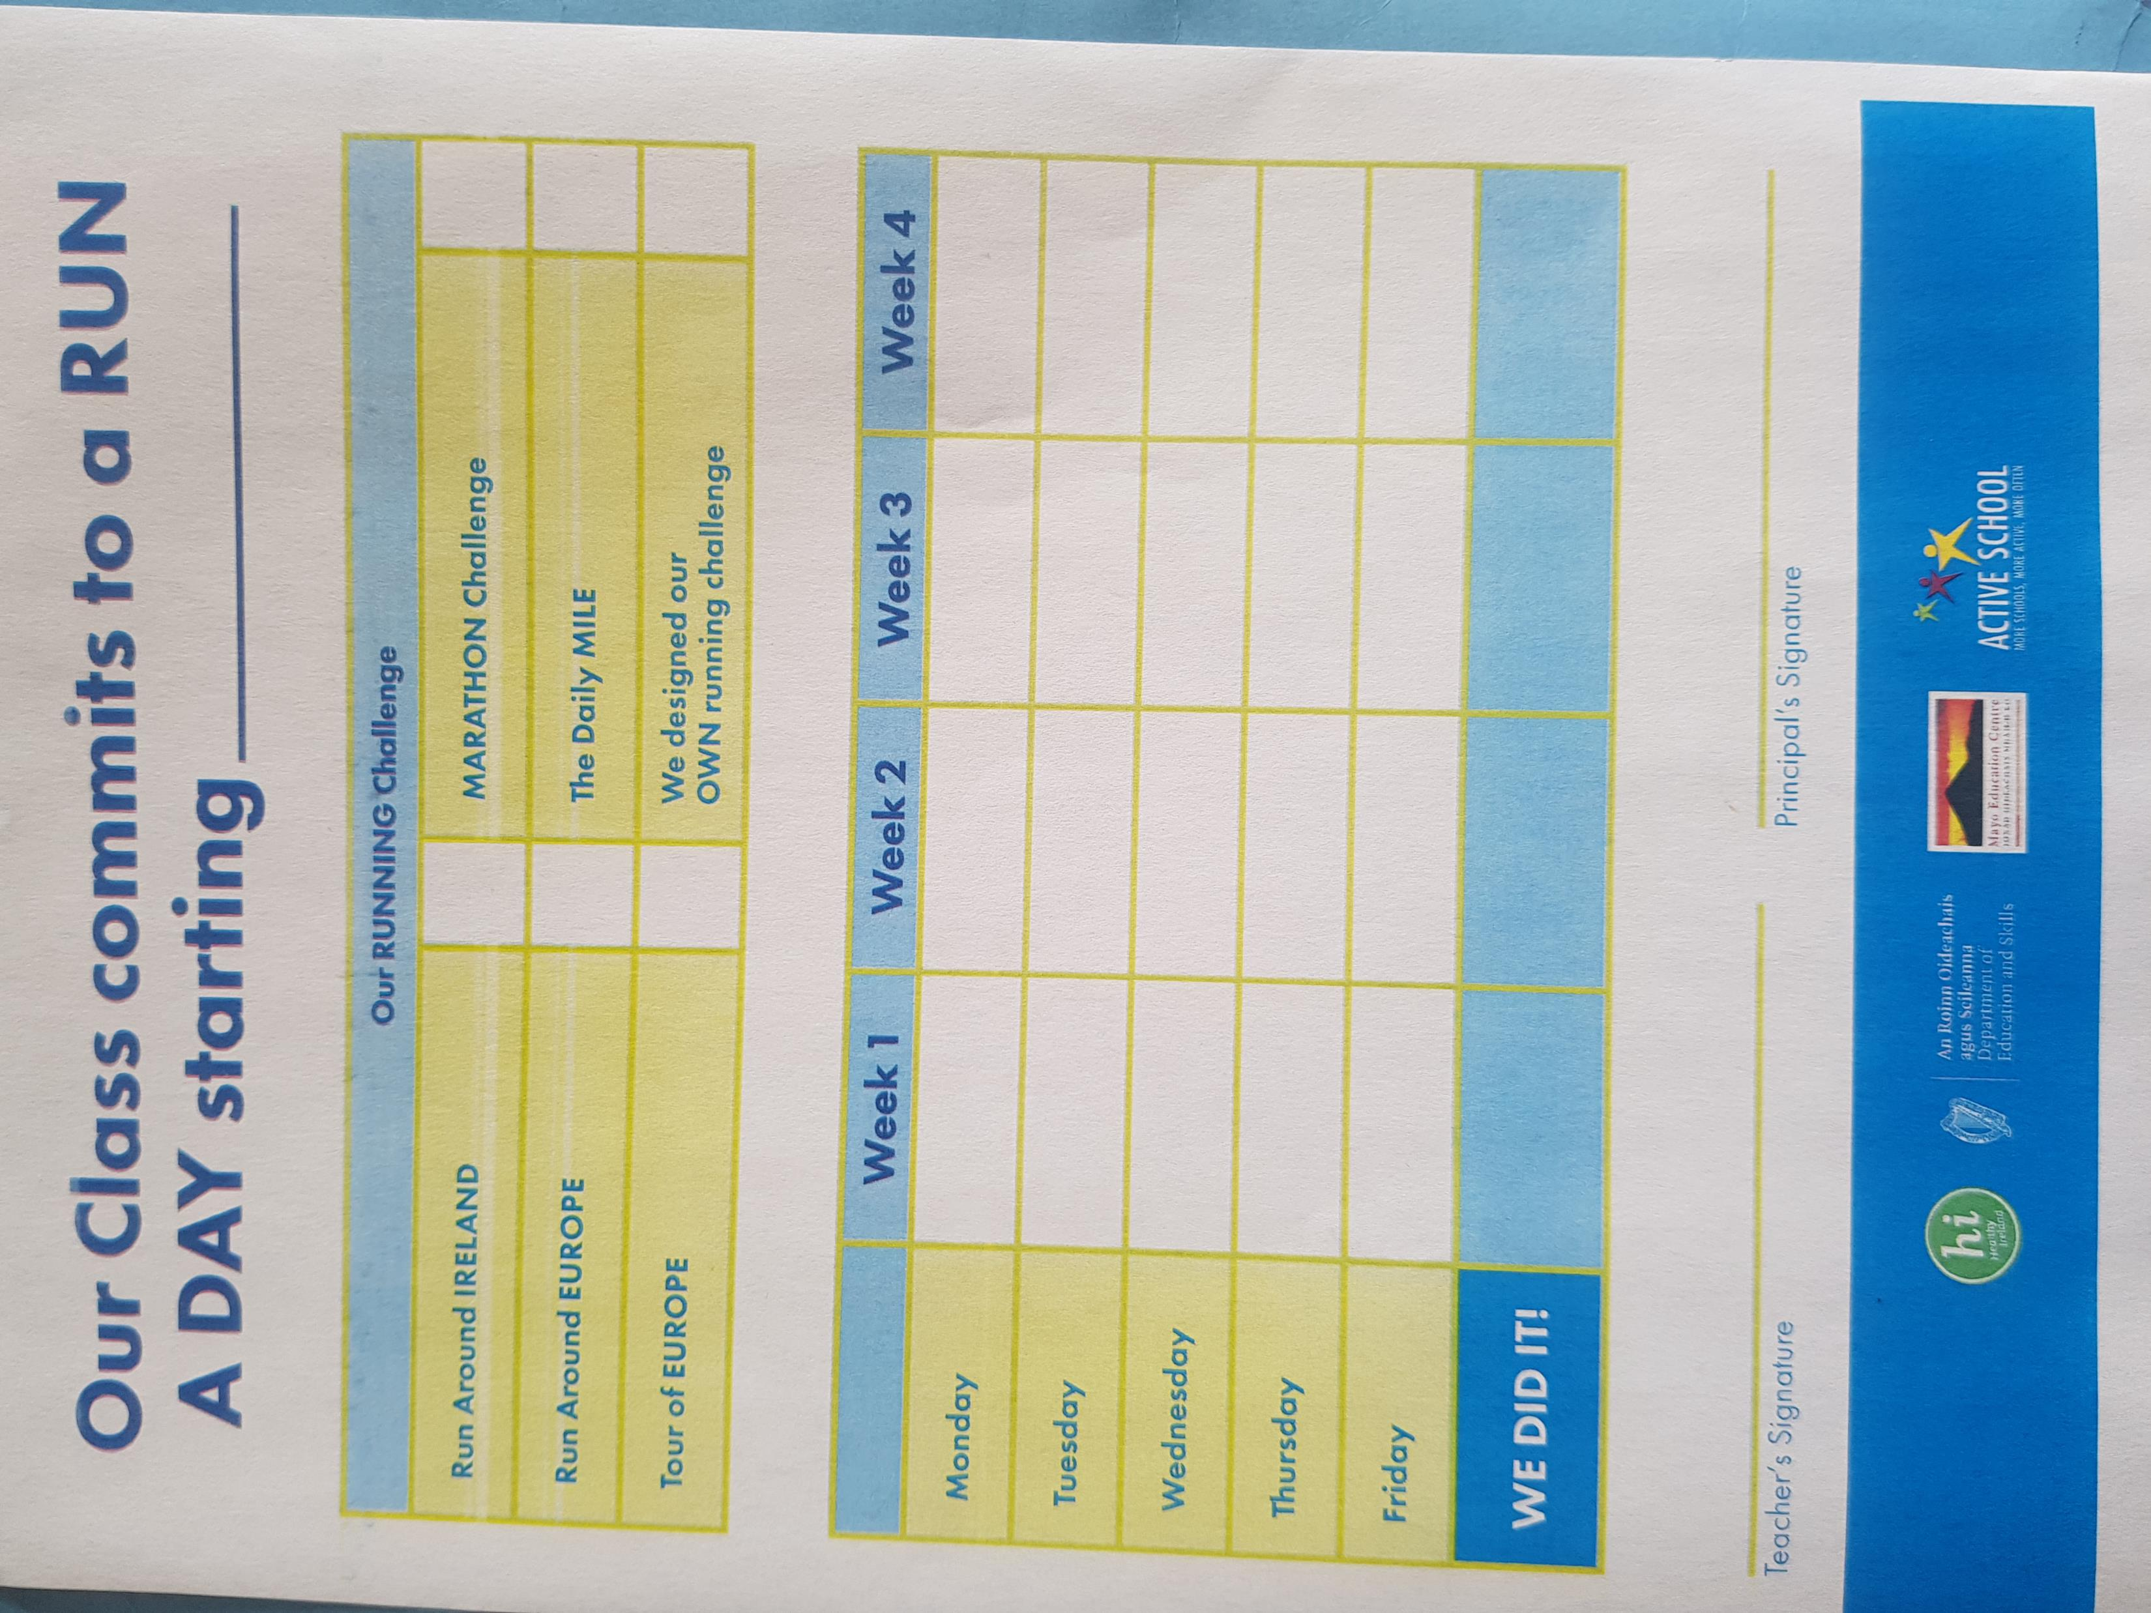
Initiatives to promote Physical Activity 2021
Walk/ Run around Europe Challenge (May 2021)
This is a great way to keep fit and to get out of the classroom and get some fresh air!
Every day the classes will go out to do laps of the yard. Each lap equates to a kilometer.
Children have the option of whether to walk or jog their laps. Each child keeps count of their laps.
In May we will hold a challenge between the classes. Each class teacher keeps a record of the total of laps (kms) completed by their class for the week.
Each week we will share how many kilometers each class did.
At the end of the 4 week challenge we will see which European country each class gets closest to.

Slide 20
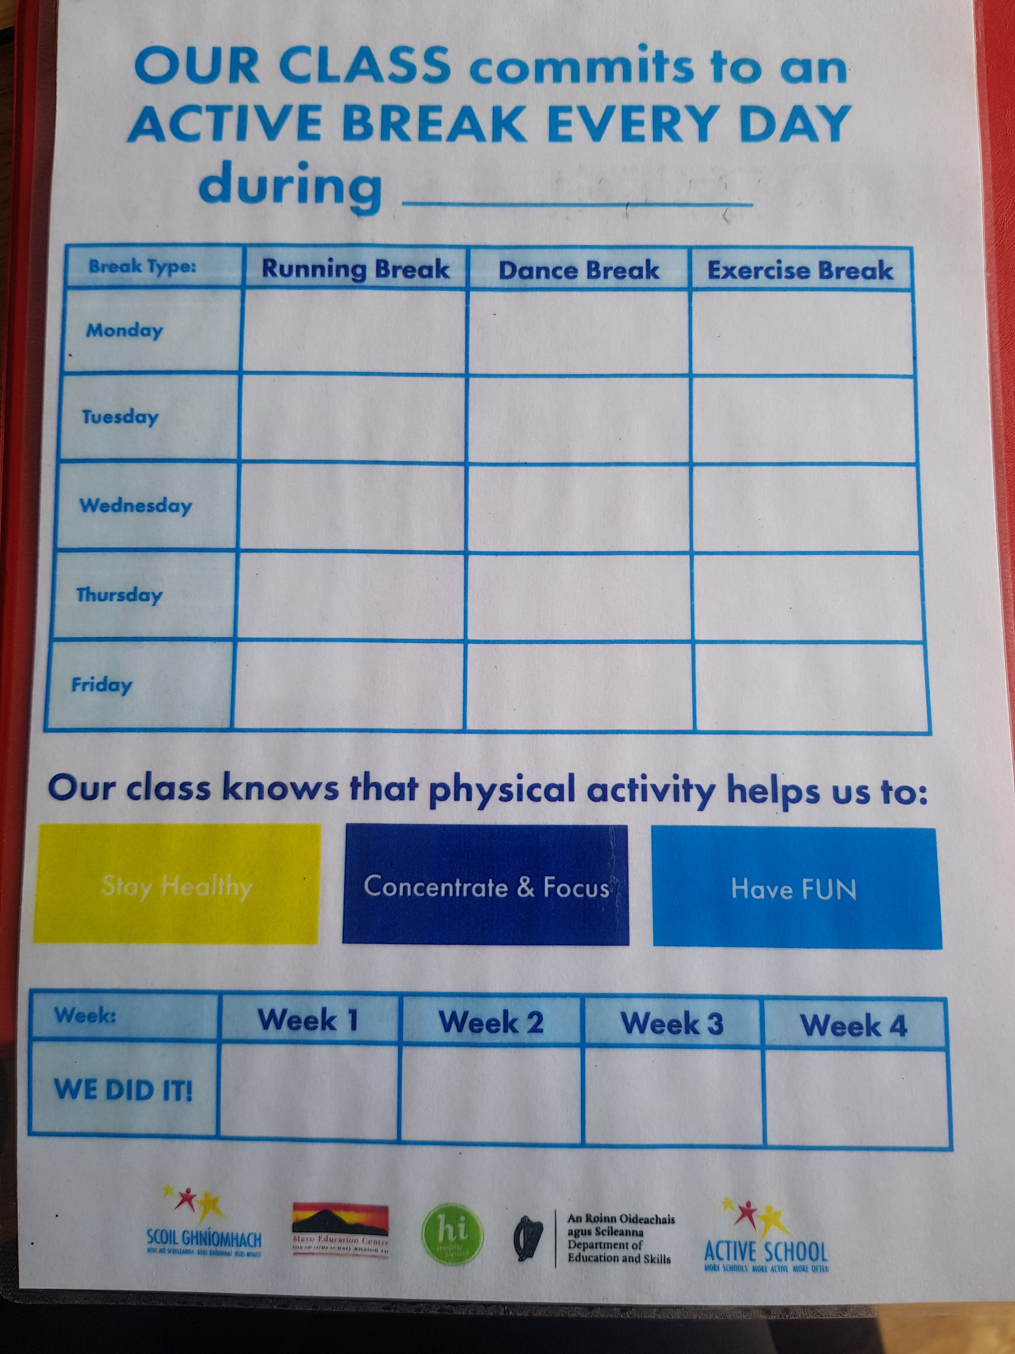
Initiatives to promote Physical Activity 2021
Active Break Every Day Challenge April)
This month we aim to do an Active break every day
This will be either a Running break, Dance break or Exercise break

Slide 21
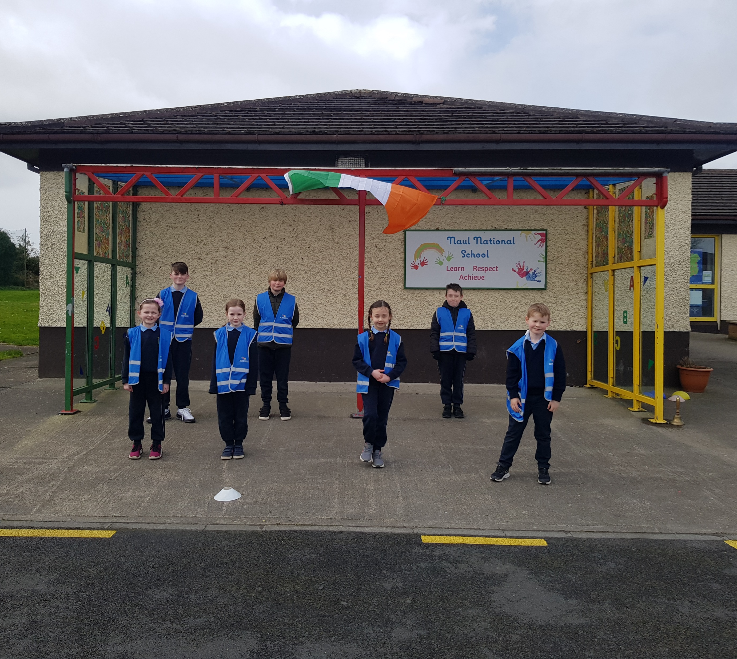
Partnerships
The pupils and staff of Naul N.S work together to promote physical activity throughout the school day.
The Active school committee have an active role in the process. They attend meetings with the Active School Coordinator (Ms. Kelly) and share the information with the teachers and classes.

Slide 22
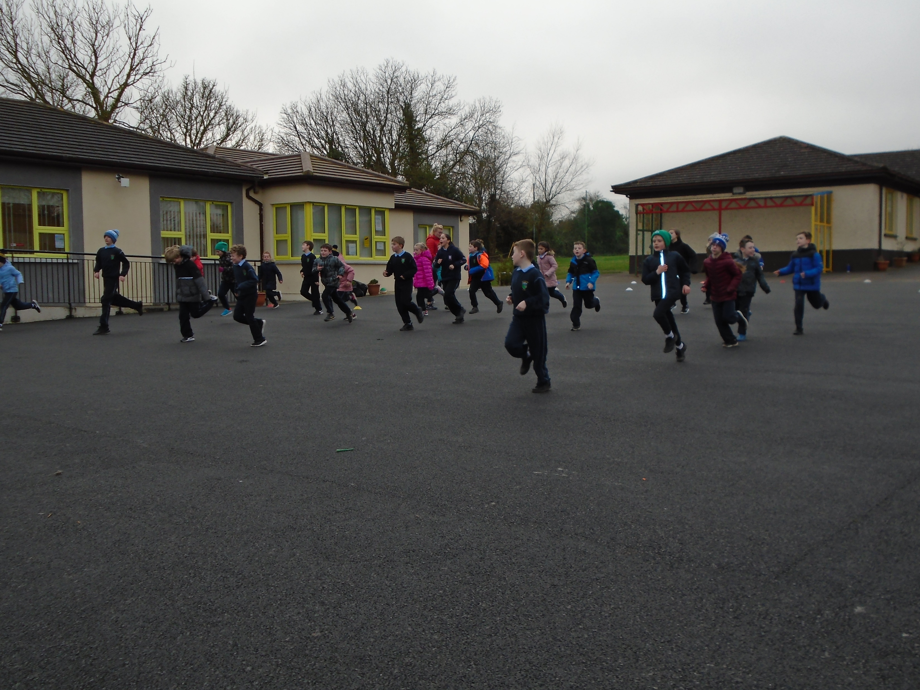
Partnerships
Naul N.S works with the Local Community
Carla Rowe from Clan Mhuire GAA club
coached the children in GAA skills and
Fundamental Movement skills prior to
Covid 19 lockdown.

Slide 23
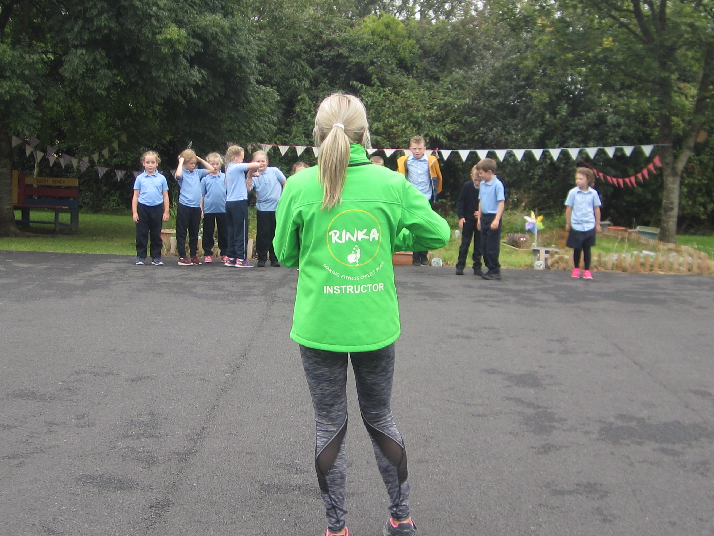
Partnerships
Naul N.S work in partnership with others to promote physical activity after school by providing after school activities (prior to Covid19)
Rinka
Soccer with Mick (FAI)

Slide 24
Partnerships
Home-school links/ Parents
The children participated in Active homework
under the supervision of their parents.
Let’s Get Active Homework booklets (2019)
Super Troopers Homework booklets (2020)

Slide 25
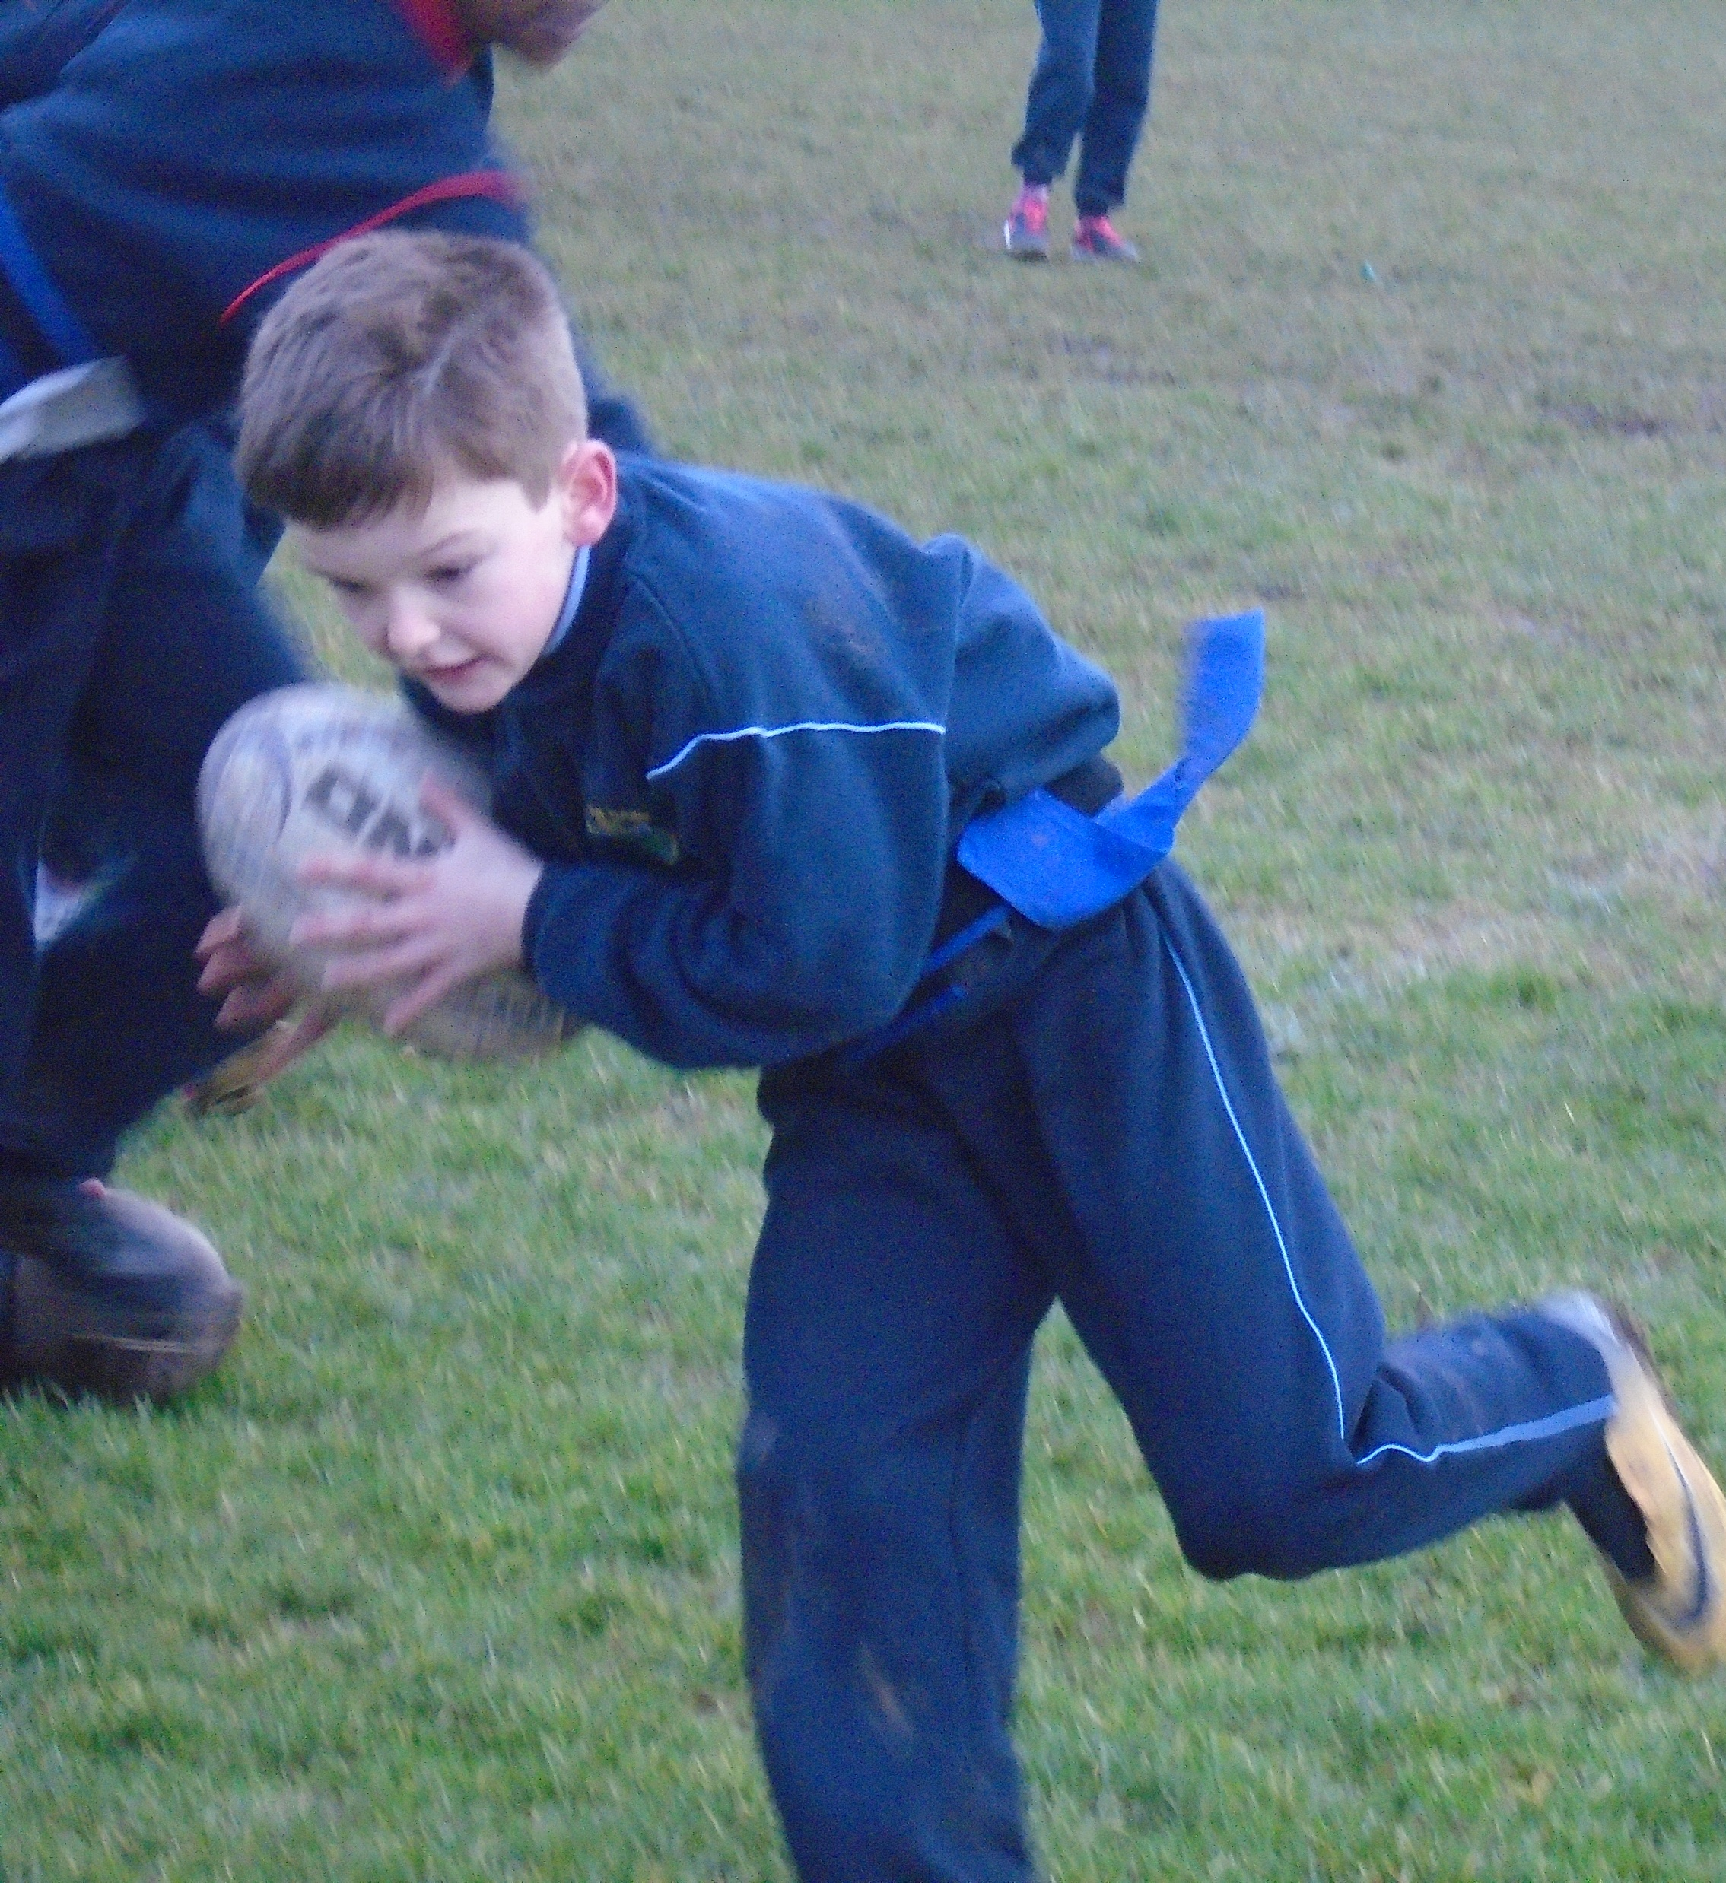
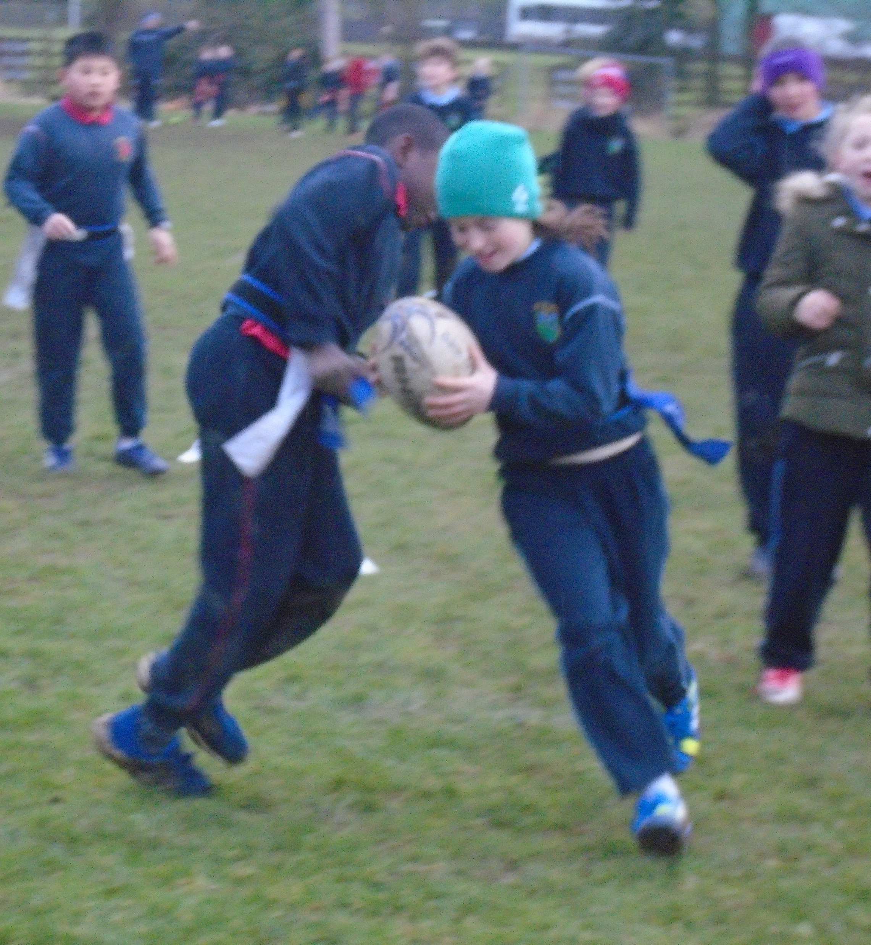
Partnerships
The children in 3rd and 4th class participated in a Tag Rugby Blitz with other schools .
This was hosted by Balbriggan R.F.C on February 13^{th,} 2019.

Slide 26
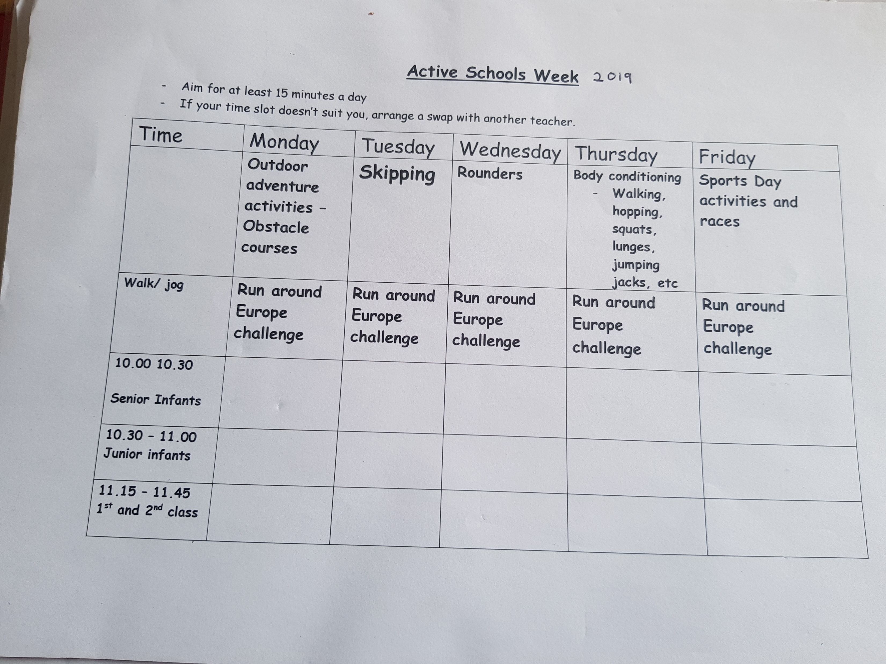
Active School Week
Over the past 4 years we have held an
Active School’s week (ASW)
which coincides with the week of the Sports day.
The children are timetabled to partake in a
different Sports Activity daily.
Here is an example of the Timetable
for Active School’s Week 2019

Slide 27
Active School Week
Sports Day is a fun event and pre-Covid 19 parents came to watch their children partake.
Sports day events include:
Welly throwing
Parachute play Athletics – Boys and Girls races
Obstacle courses - Relay races
Bean bag race - Holiday Race
Egg and spoon race - Parents race
Sack race - Toddler Race
3-legged race

Slide 28
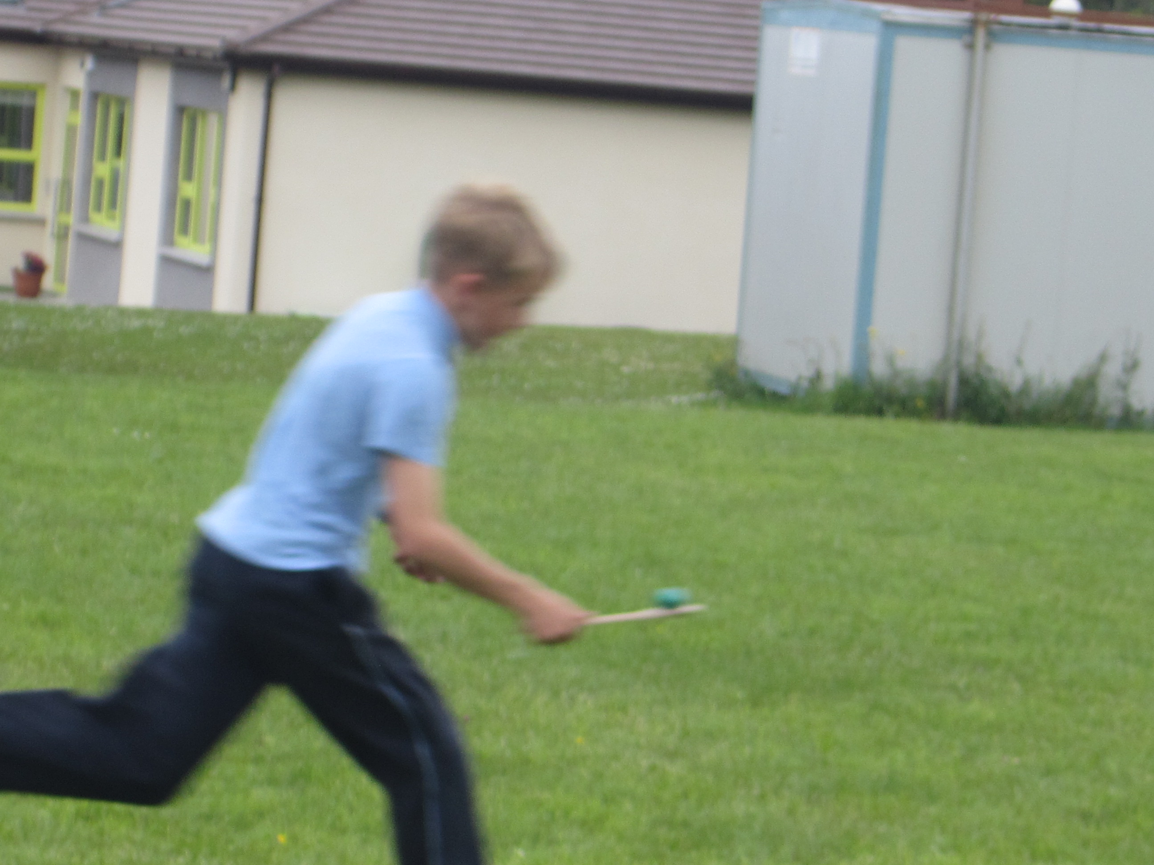
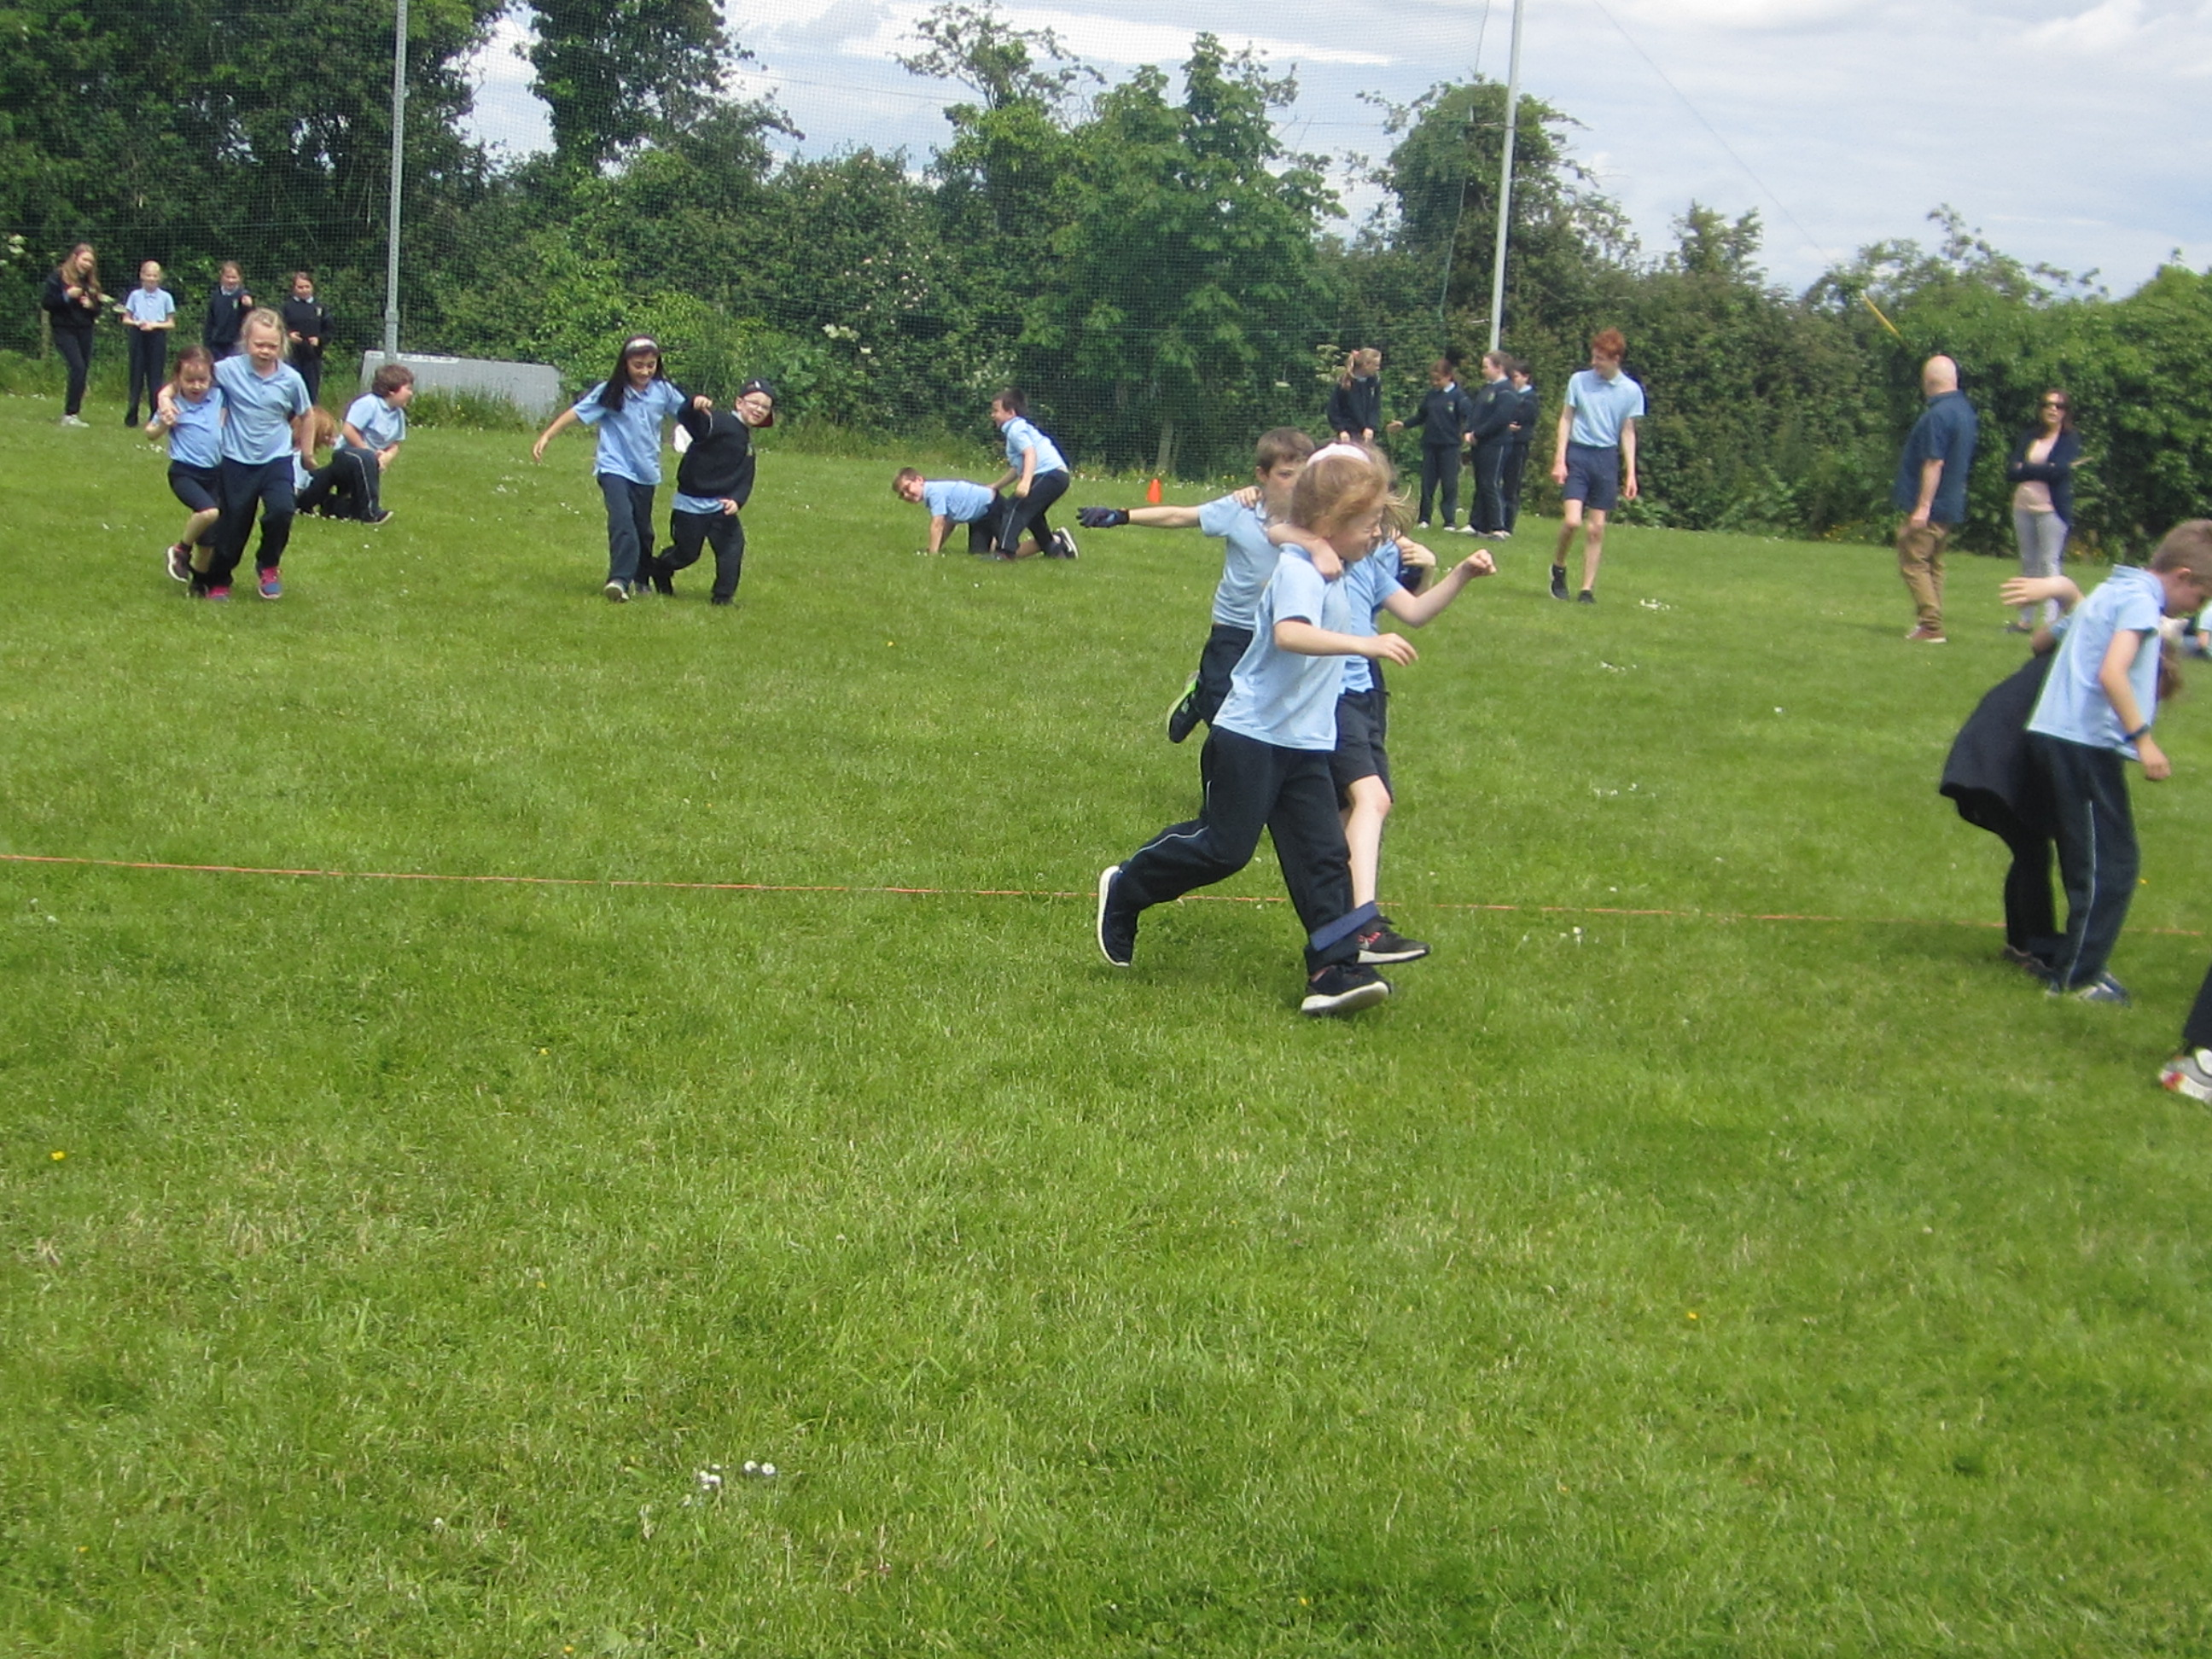
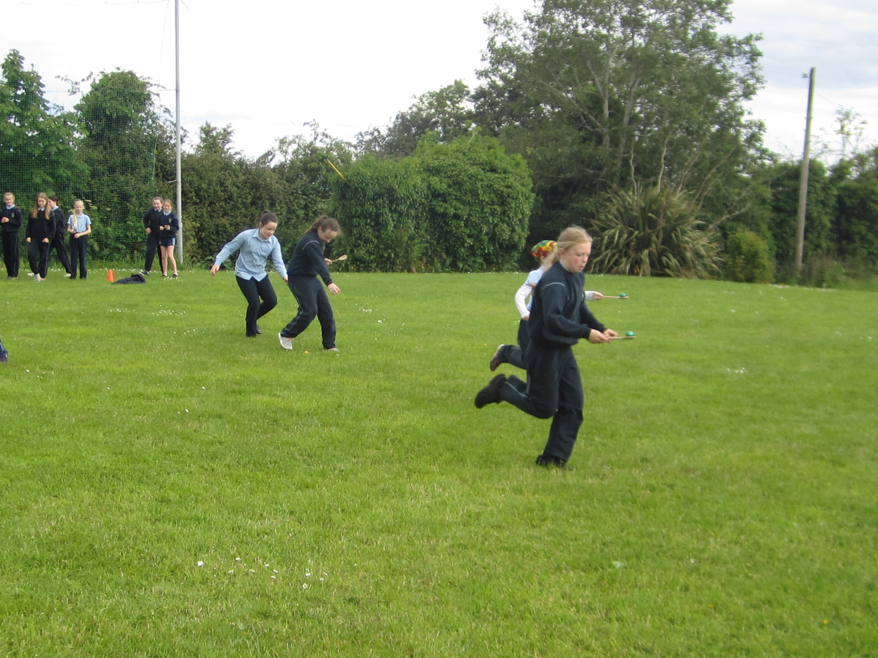
Active School Week 2019
Here are some photo’s of Sports Day events

Slide 29
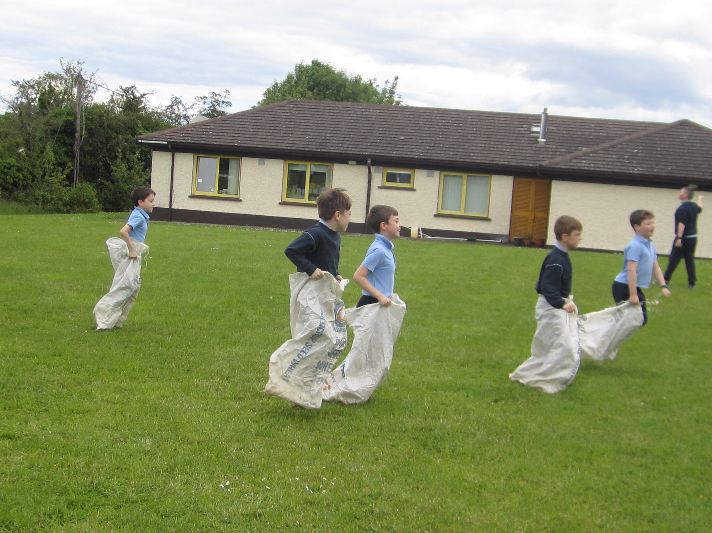
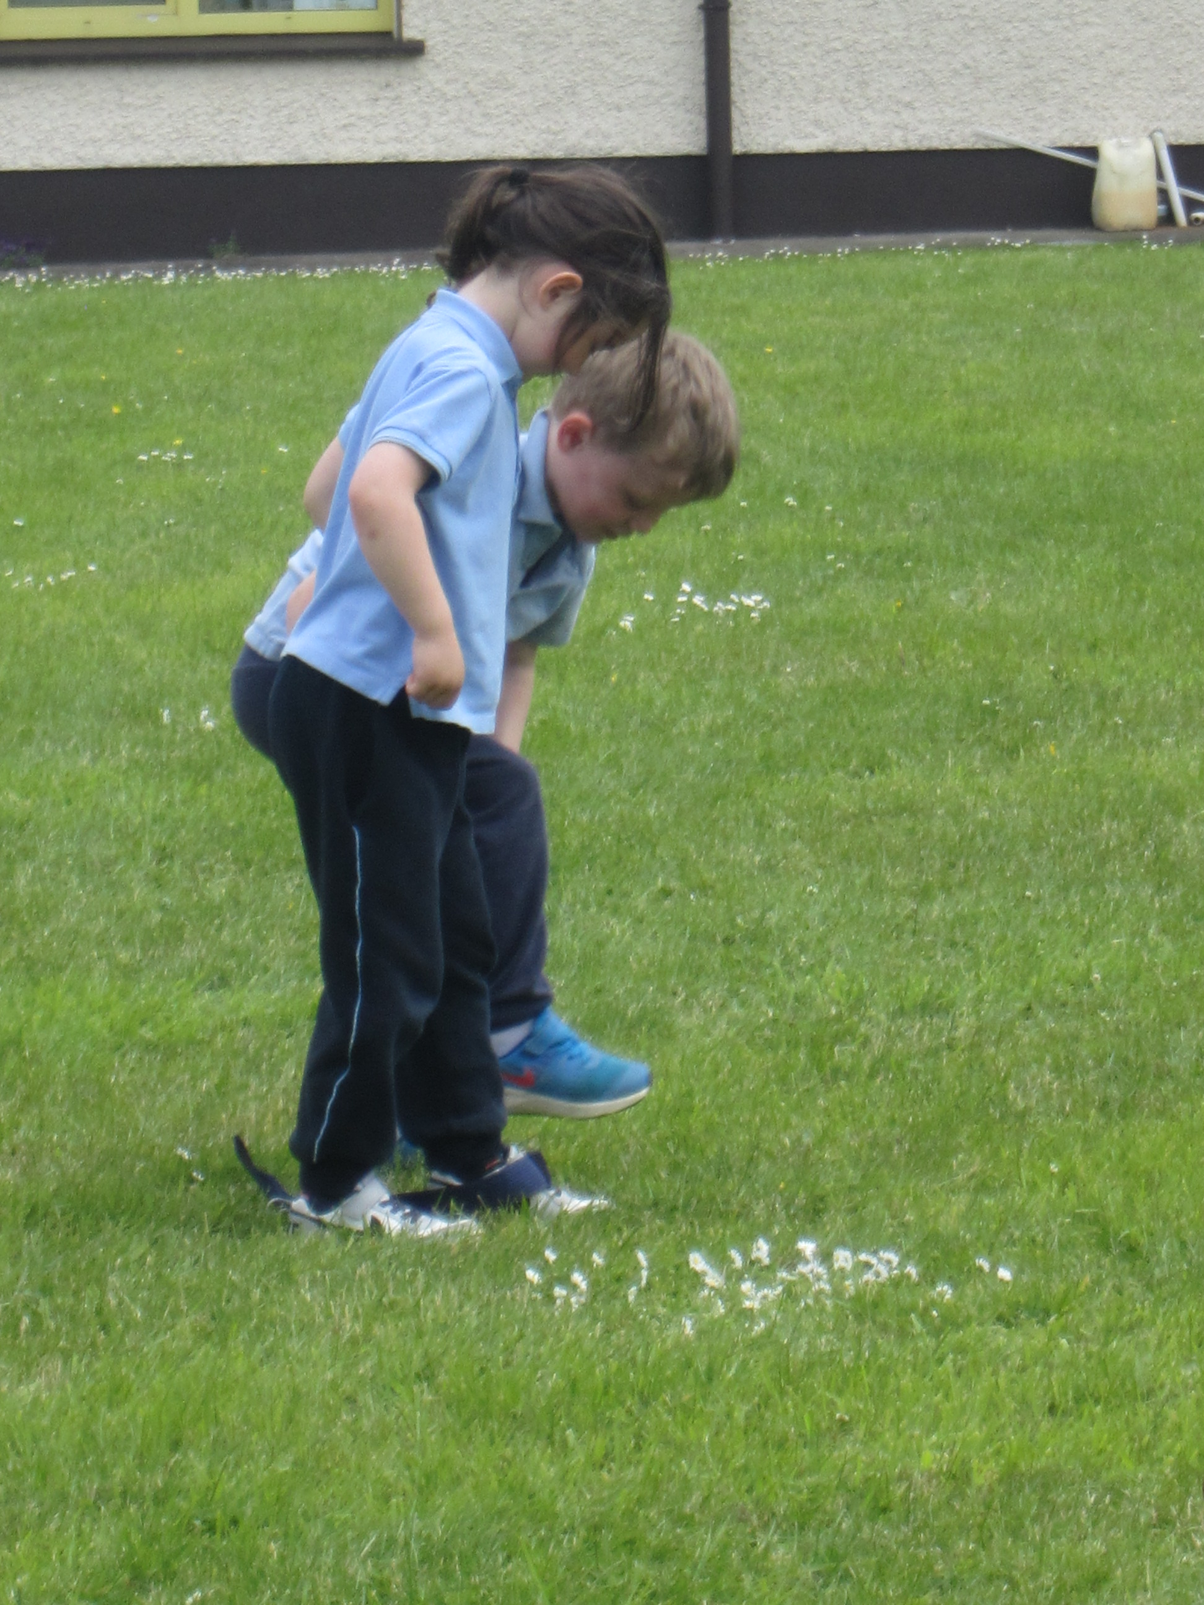
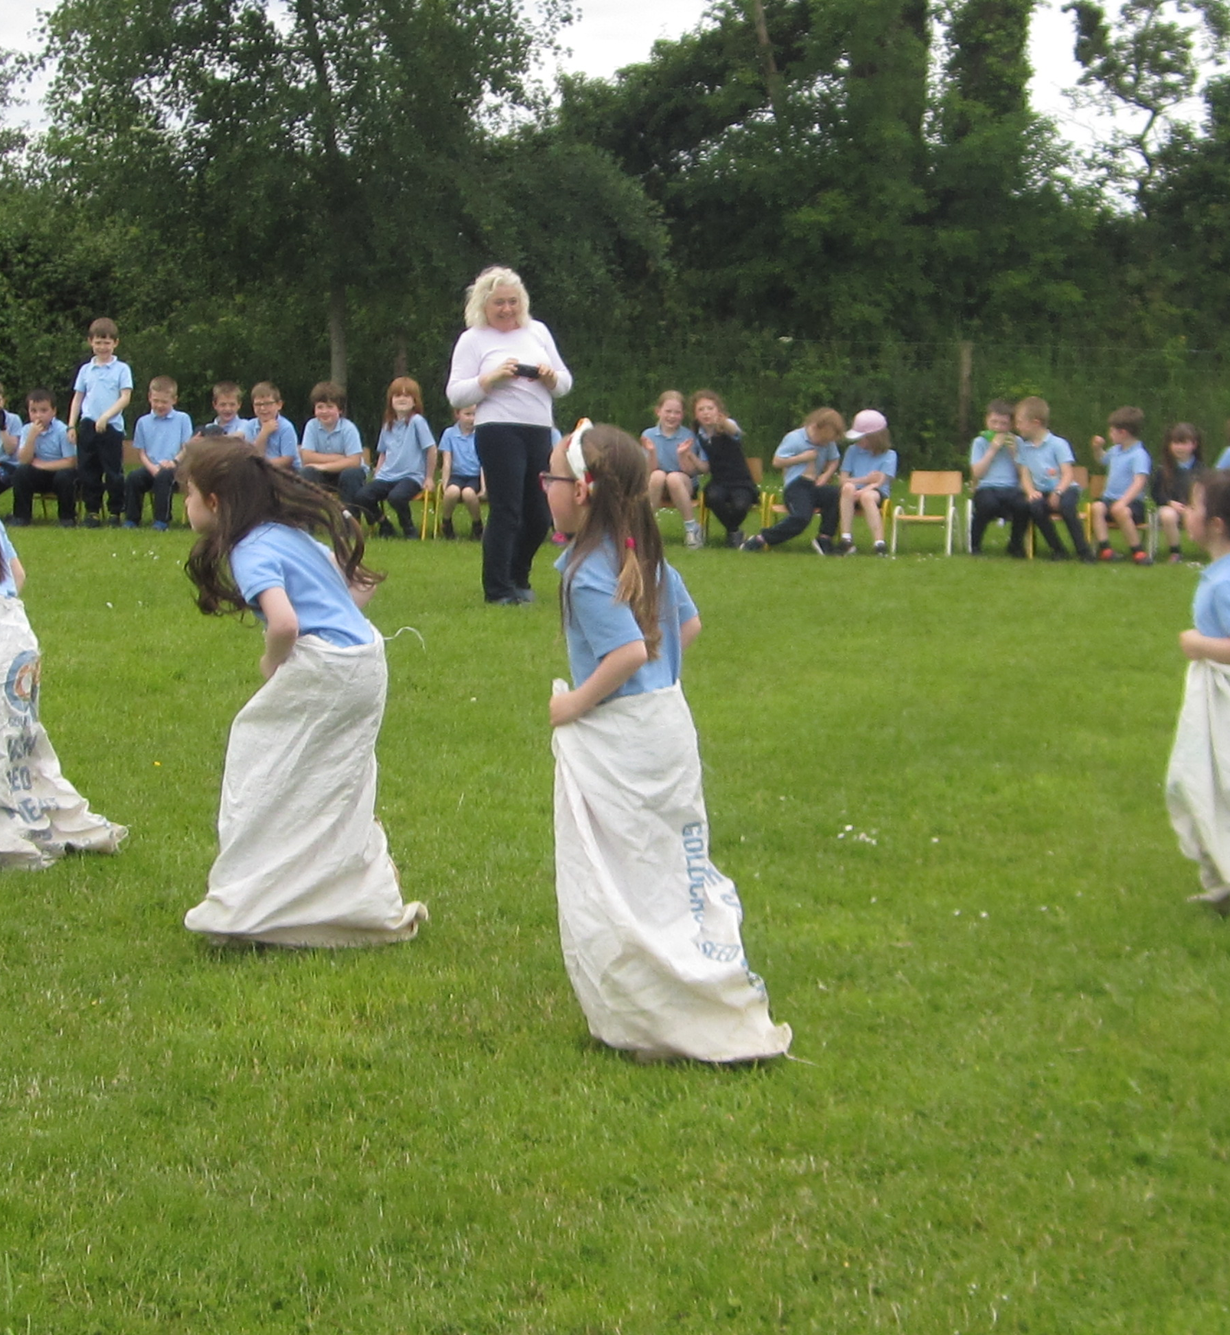
Active School Week 2019
Here are some photo’s of Sports Day events

Slide 30
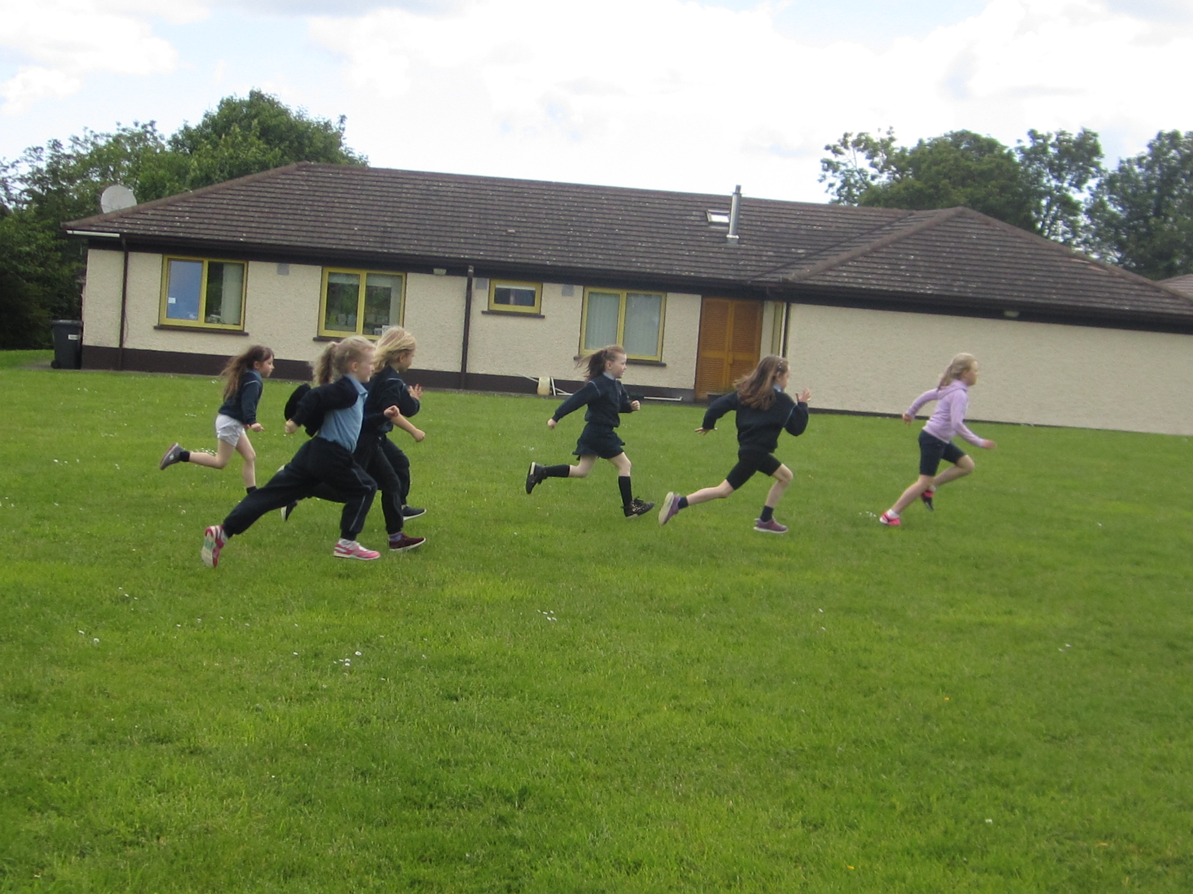
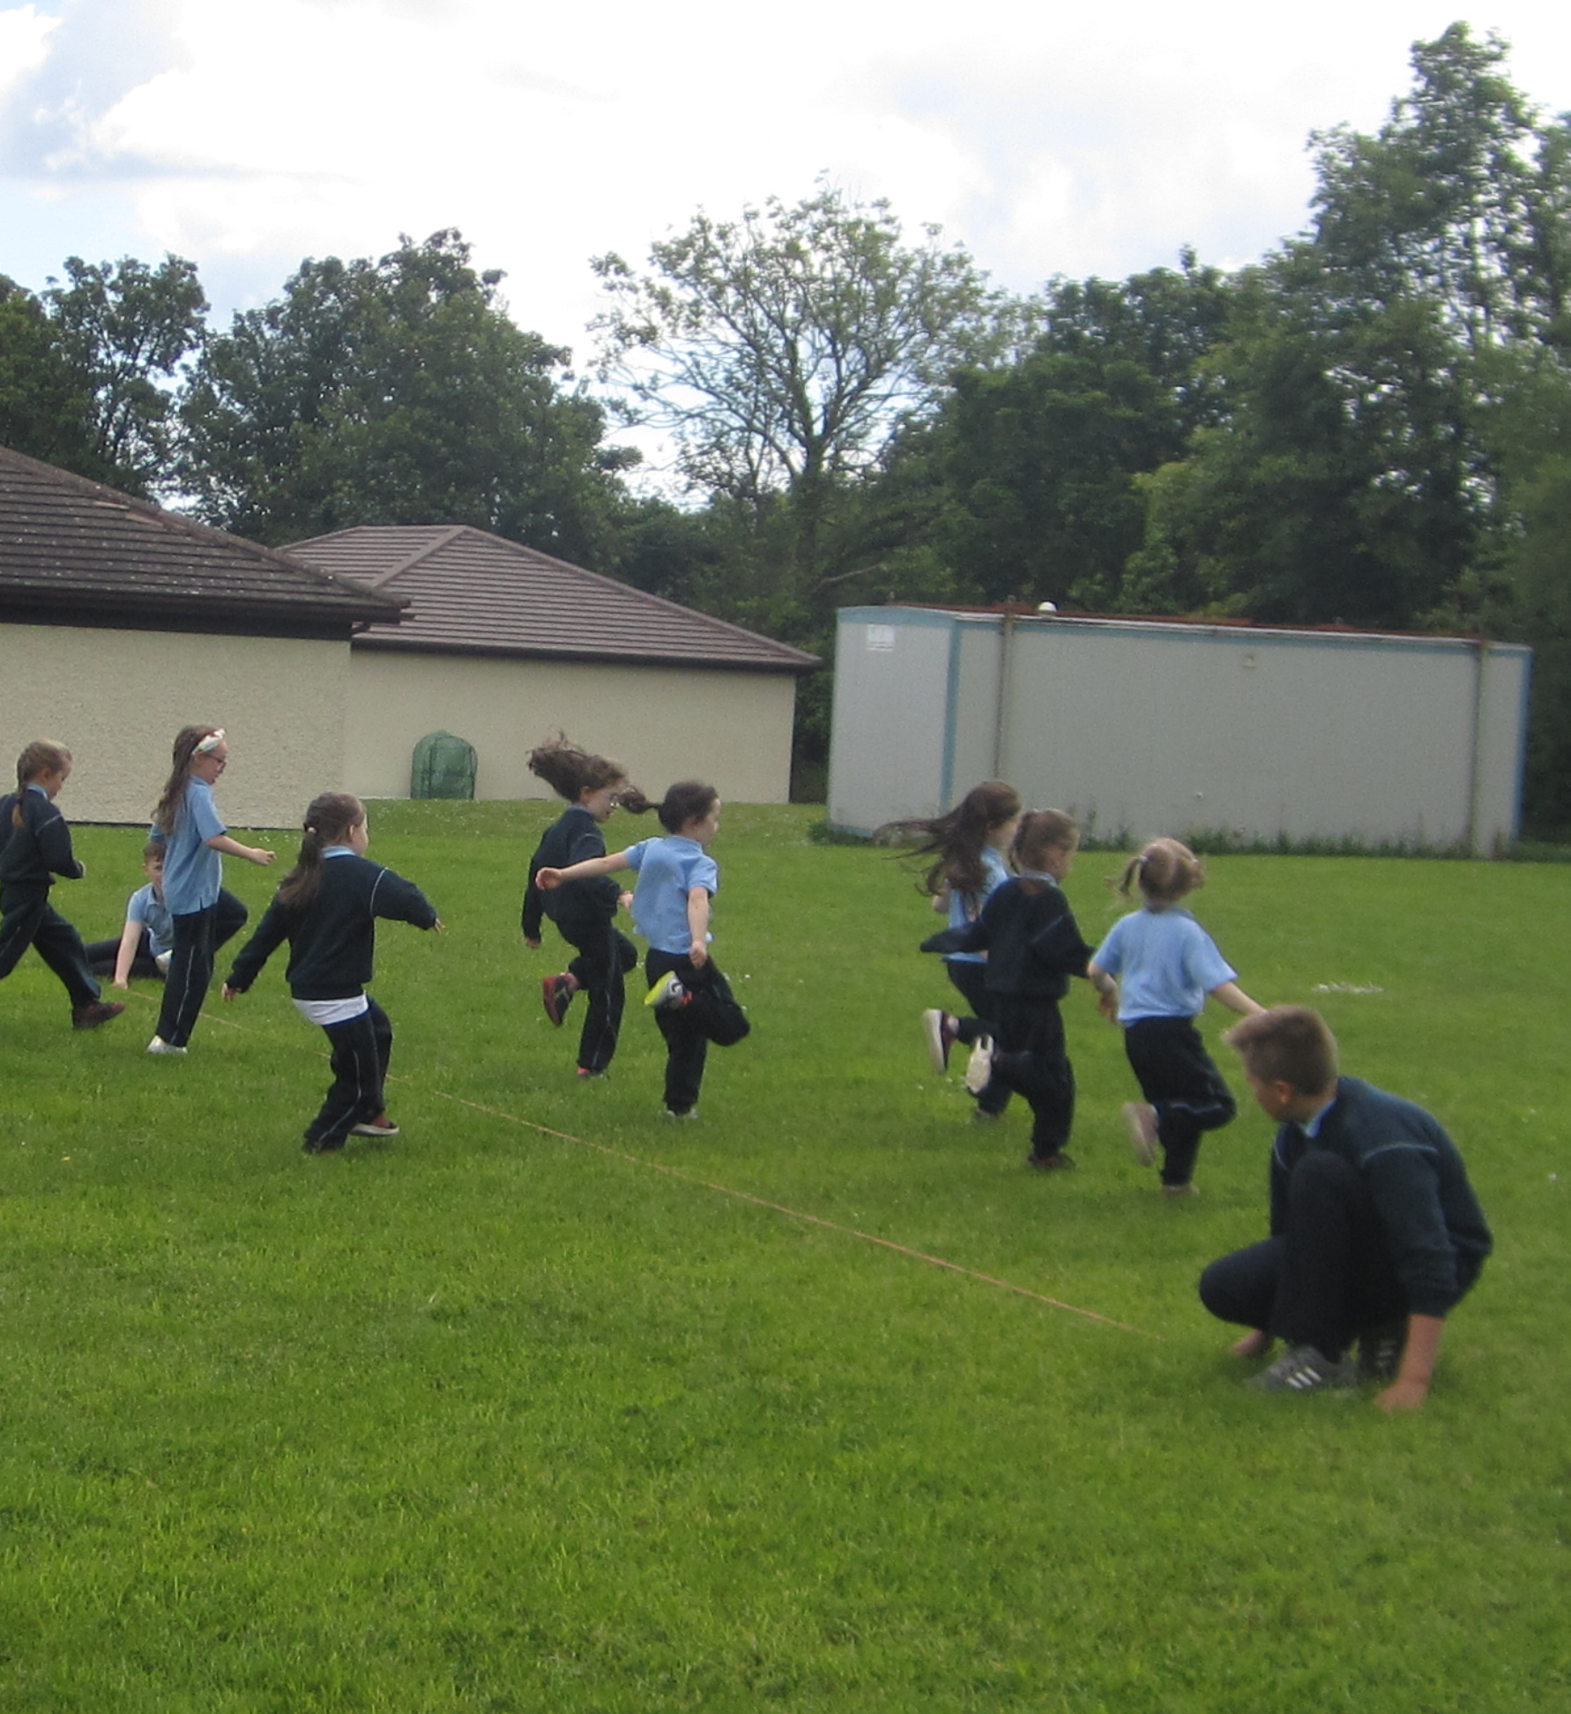
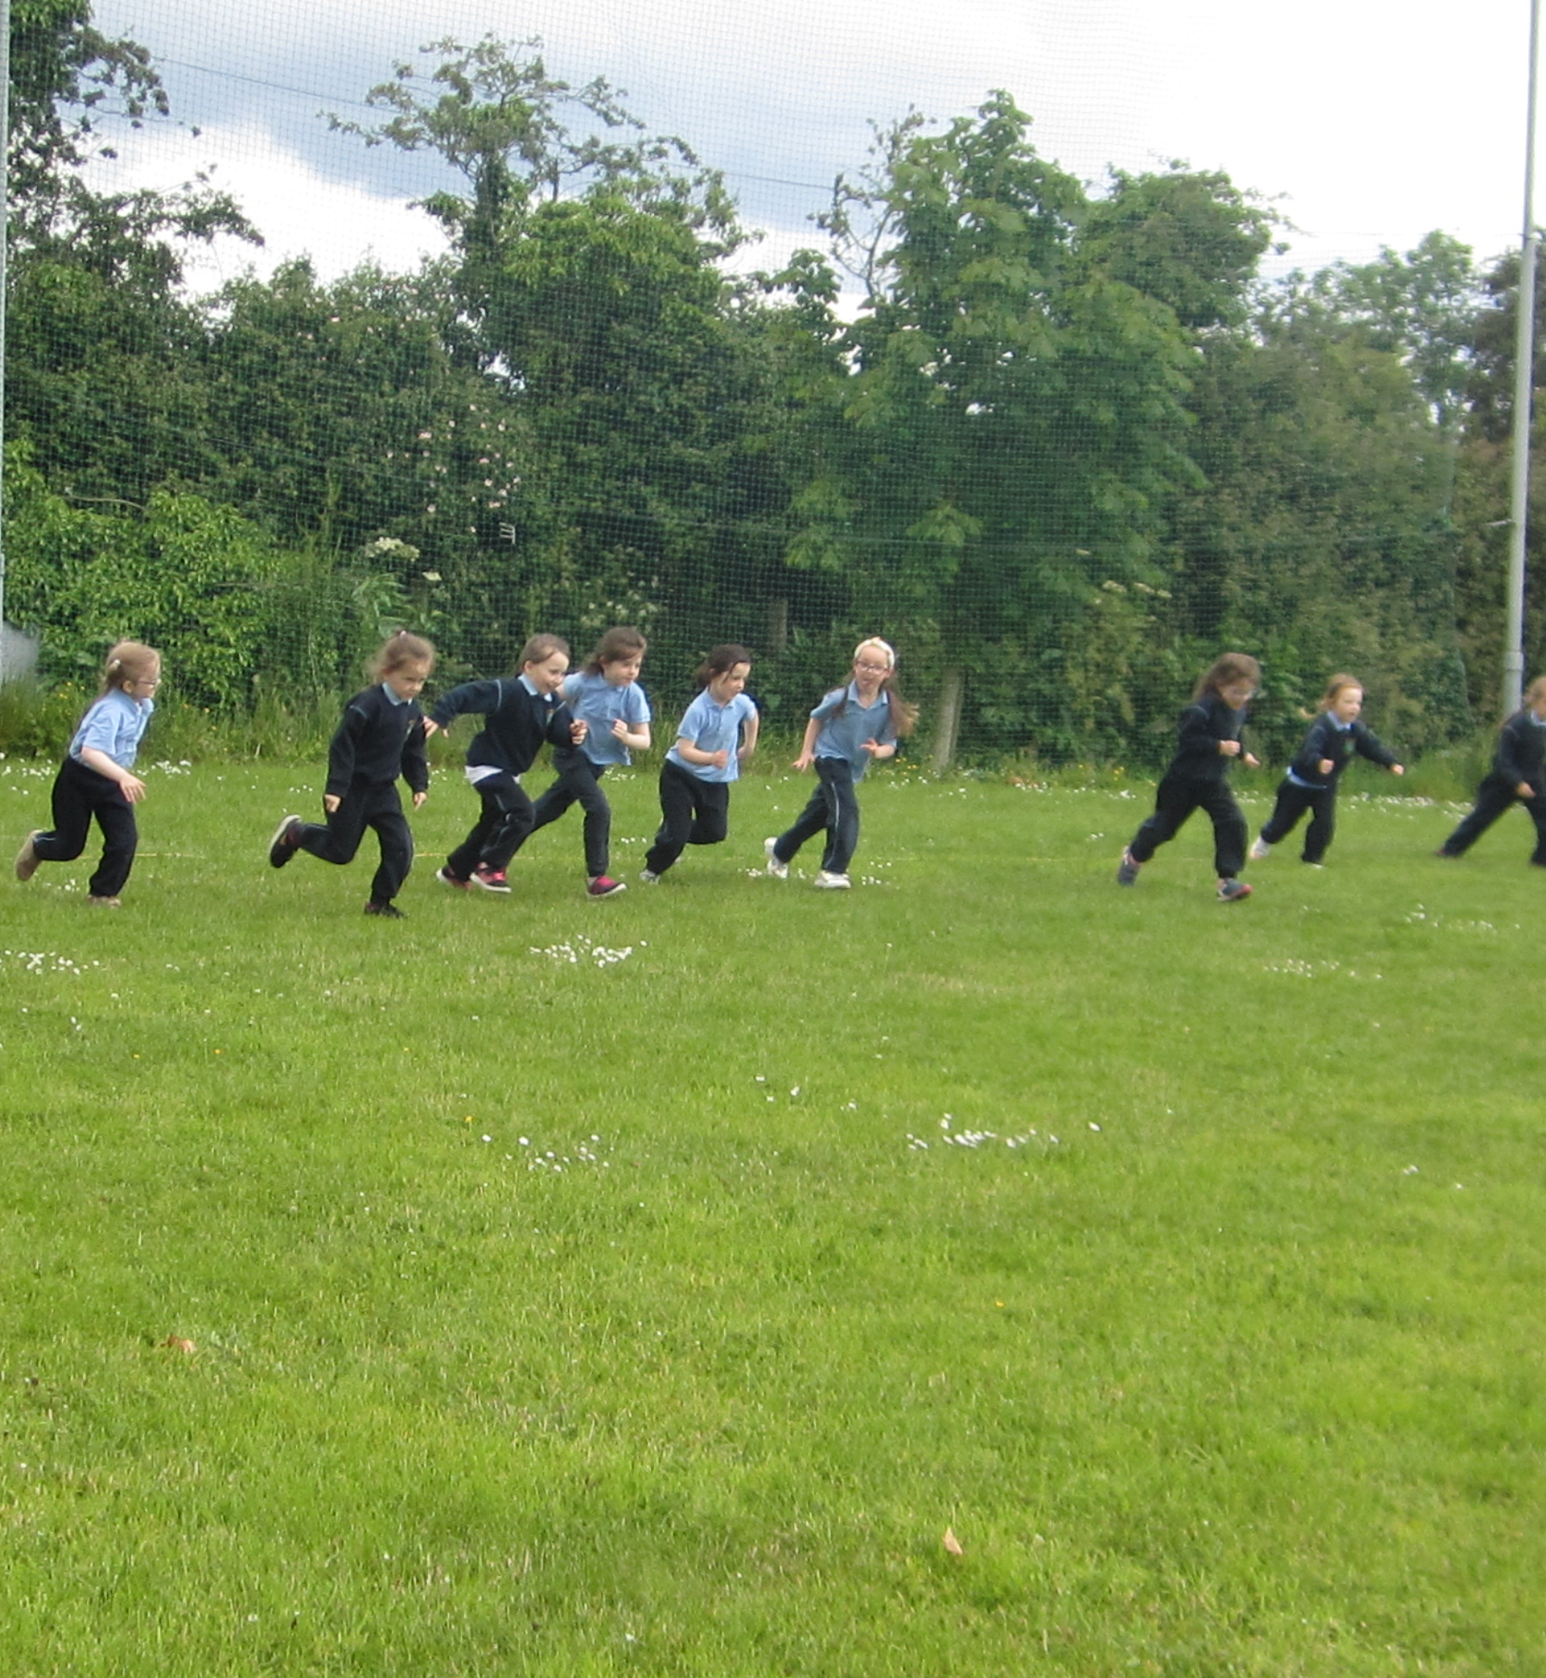
Active School Week 2019
Here are some photo’s of Sports Day events

Slide 31
Active Home Week
Despite lockdown due to Covid 19, the children still participated in Active Home Week
Many of the children also held a Sports day at home.
Teachers sent activities and ideas to the children and parents.

