Slide 1
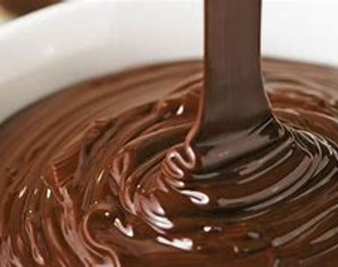
How long does it take certain lightbulbs to melt chocolate?
5th and 6th Class, Naul National School

Slide 2
Predictions
We predicted that the stronger light would melt the chocolate the quickest.
We decided for a fair trial that we would need to keep conditions the same for each light bulb. This meant using the same brand of chocolate and the same plate.

Slide 3
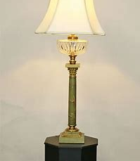
Preparation
We collected all the materials we would need
We got an old lamp, lightbulbs in different strengths, cooking chocolate, plate, thermometer and a stopwatch.
We used pegs to balance the plate on the lamp.

Slide 4
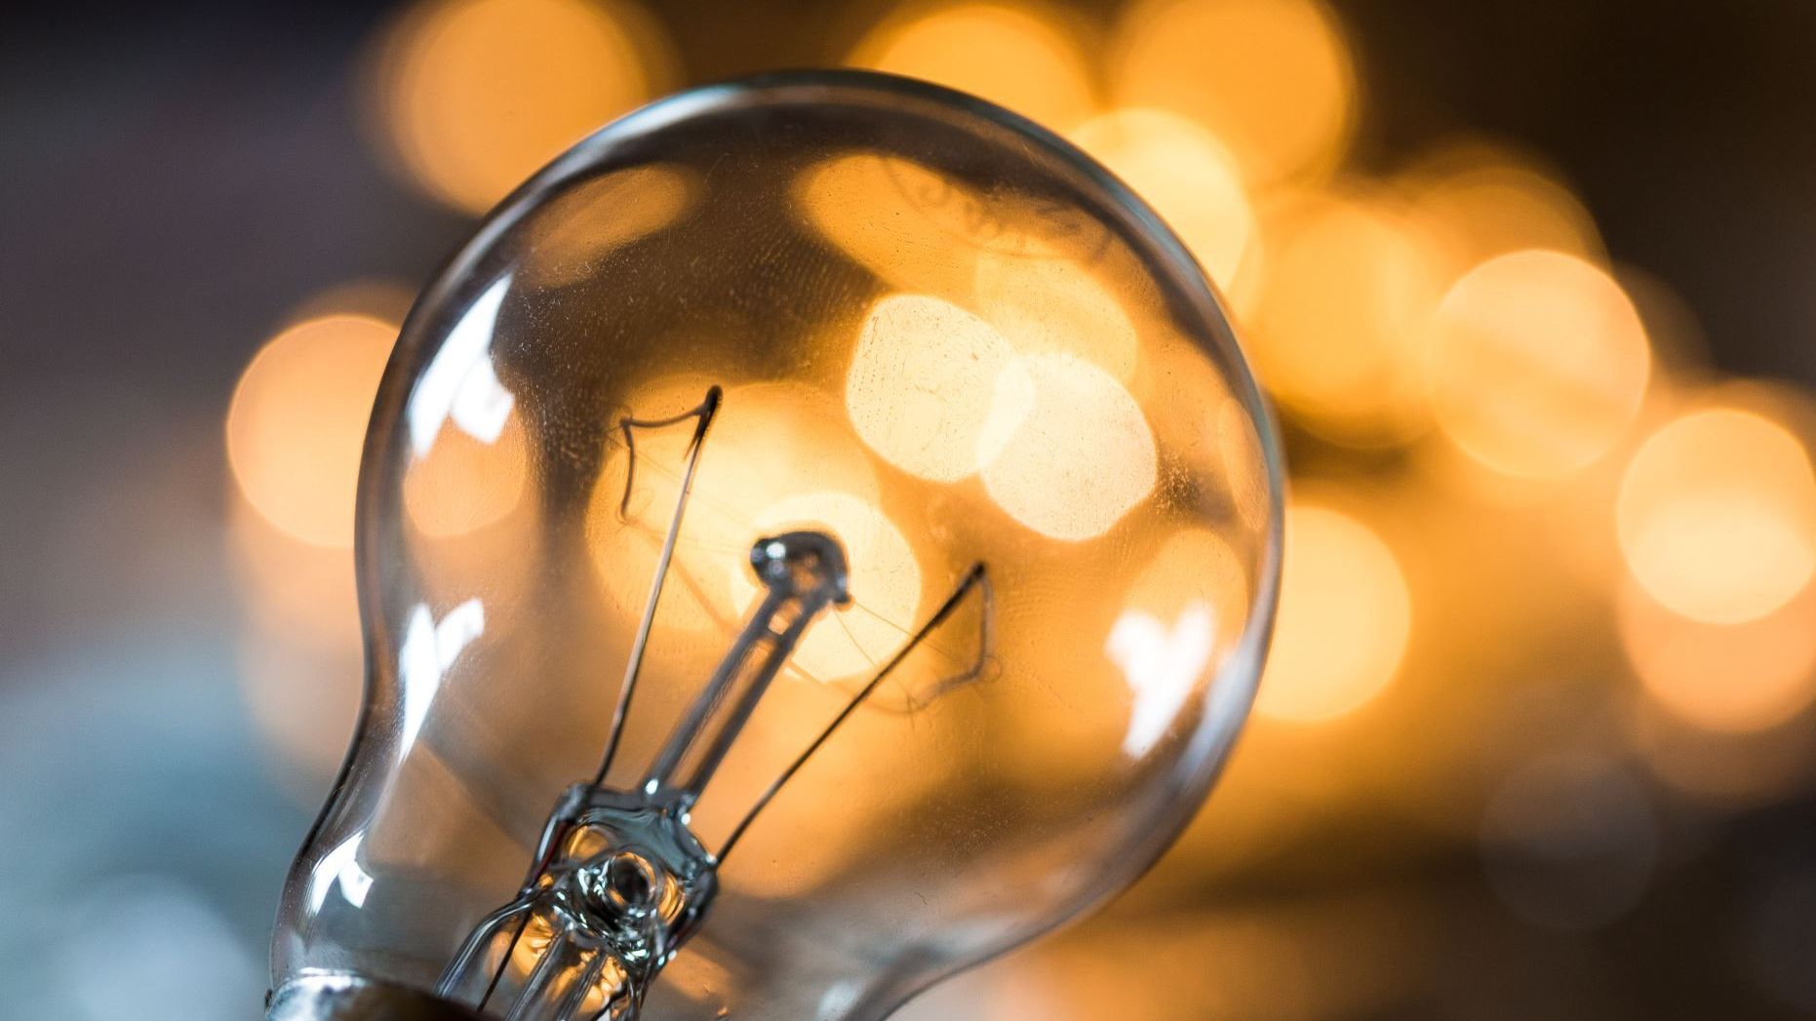
Method
Insert chosen lightbulb into lamp
Carefully position plate over the lamp
Place chocolate in centre of plate
Turn the lamp and timer on at the same time
Record the results
Repeat the process for each bulb individually

Slide 5
Results
Bulb | Time first sign of melting | Temperature on thermometer | Final observation | Temperature on thermometer
100W | 1 hour on the stopwatch | 27°C | 1 hour 30 minutes | 30°C
60W | 1 hour on the stopwatch | 21.5°C | 1 hour 30 minutes | 25°C
40W | 1 hour on the stopwatch | 21.3°C | 1 hour 30 minutes | 21.8°C
60W (old style) | 15 minutes | 36.5°C | 30 minutes | 40.1°C
40W (old style) | 15 minutes | 34.7°C | 30 minutes | 39.8°C

Slide 6
Observations
We observed that the 100W bulb did a better job of melting the chocolate than the 60W bulb and the 40W bulb
We decided to try two old filament bulbs. We found that these melted the chocolate much quicker than the newer bulbs

Slide 7
Conclusion
We concluded that the higher the wattage of the bulb, the greater the chance of it melting the chocolate.
We also decided that the older bulbs were far superior for melting chocolate than the newer energy saver bulbs.
We noted that the older bulbs would need a lot more electricity to power because they not only emit light, but they also emit a great deal of heat. This means that they would not be as good for the environment as the newer energy saving bulbs.

